Slide 1



Weekly Review
Gobind Sugar Mill, Aira
18th Oct. to 24th Oct. 2025

Slide 2
Production & Sales (Budget vs Actual)
Production (F.Y. 2025-26)
Particulars | Current Month (Oct,25) |  | Last Month (Sep,25) |  | YTD Till Last Month (Up to Sep,25)
 | Budgeted | Actual-till 24th Oct, 25 | Budgeted | Actual | Budgeted | Actual
Sugar (LQ) | 0.33 | - | - | - | - | -
Power (LU) | 67.20 | 14.27 | 14.59 | 20.75 | 138.74 | 127.64
Ethanol (LL) | 13.20 | 7.73 | 22.11 | 27.75 | 192.51 | 187.03
 |  |  |  |  | Oct.25 | 7.73
 |  |  |  |  | Total Up to Oct.25 | 194.76
Sales (F.Y.2025-26)
Particulars | Current Month (Sep ,25) |  | Last Month (Sep,25) |  | YTD Till Last Month (Up to Sep,25)
 | Budgeted | Actual till 24th Oct, 25 | Budgeted | Actual | Budgeted | Actual
Sugar (LQ) | 1.29 | 0.77 | 1.30 | 1.24 | 7.40 | 7.26
Power (LU) | 43.61 | 6.25 | 0.66 | 2.93 | 12.96 | 18.99
Ethanol (LL) | 13.20 | 22.78 | 22.11 | 20.81 | 192.51 | 174.62
 |  |  |  |  | Oct. | 22.78
 |  |  |  |  | Total Up to Oct.25 | 197.40
Notes:
Ethanol Production during week 18.10.25 to 24.10.25- 1.38 Lac B.L.& Sale 3.29 Lac B.L.

Slide 3
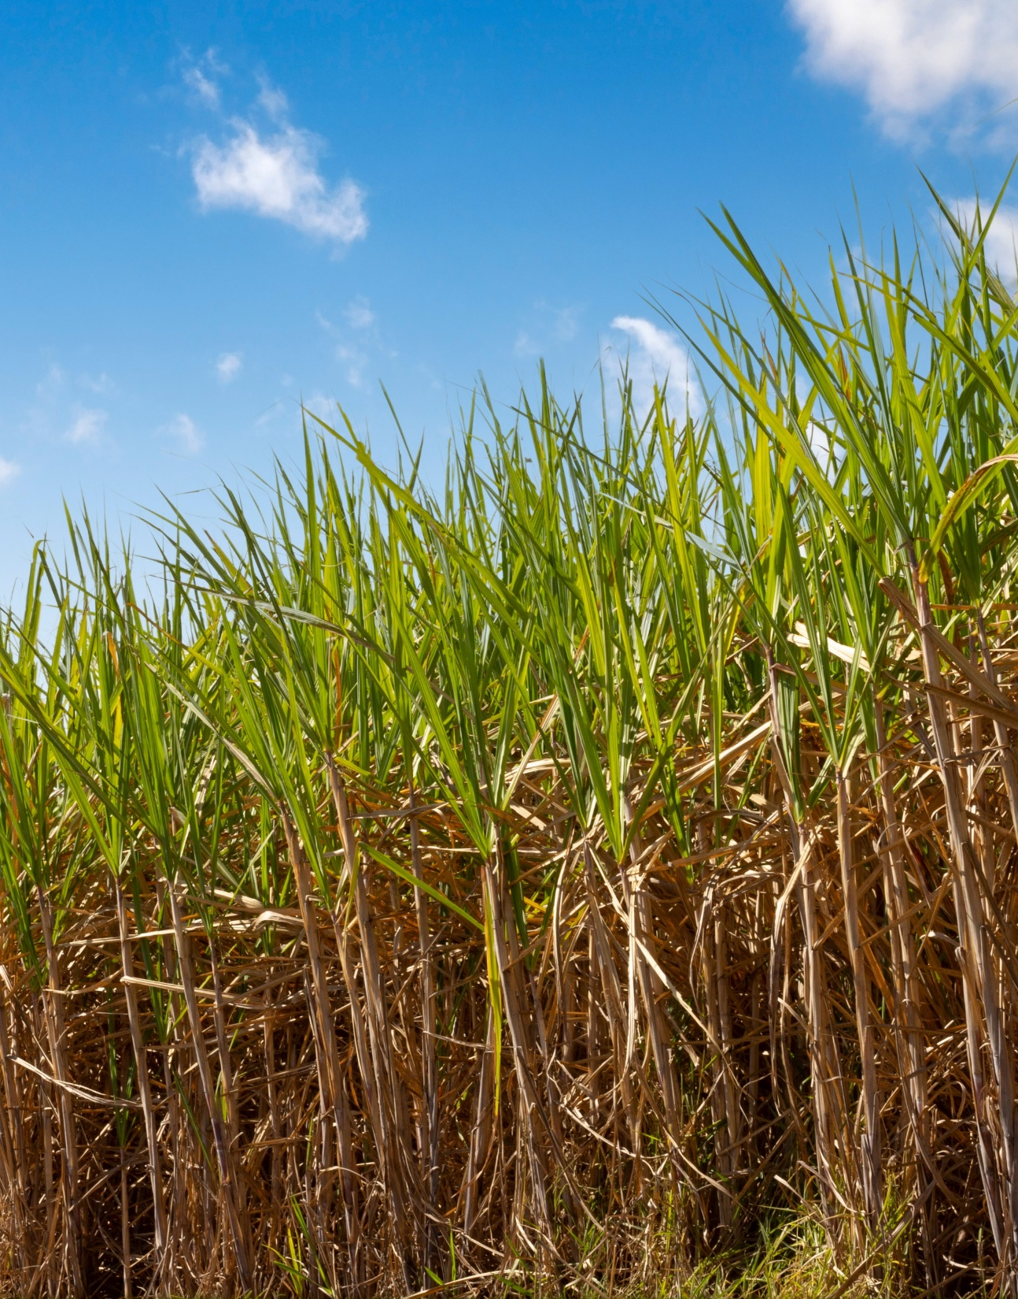
CANE

Slide 4
Date wise purchase and crush report
Date | Cane Purchase (Qtls.) | Crushing (Qtls.) | Remark
24-10-2025 | 2200 | 0 | Not Running
25-10-2025 | 20911 | 23111

Slide 5
SOCIETY WISE INDENT AND SUPPLY (UP TO 25.10.2025)

Slide 6
Cane Supply
Day | Date `24 | Cane Purchased (qtls) 2024-25 | Date `25 | Proposed Supply (qtls) (25- 26) | No. of Functional Centers
1 | 25-Oct | 3168.62 | 24-Oct | 3200 | 30
2 | 26-Oct | 13653.07 | 25-Oct | 25000 | 61
3 | 27-Oct | 32465.57 | 26-Oct | 47000 | 72
4 | 28-Oct | 43525.18 | 27-Oct | 55000 | 75
5 | 29-Oct | 51142.61 | 28-Oct | 65000 | 80
6 | 30-Oct | 56153.47 | 29-Oct | 80000 | 85
7 | 31-Oct | 54543.54 | 30-Oct | 95000 | 95
8 | 1-Nov | 47673.57 | 31-Oct | 100000 | 107
9 | 2-Nov | 61281.42 | 1-Nov | 105000 | 107
10 | 3-Nov | 66659.21 | 2-Nov | 110000 | 107
11 | 4-Nov | 78672.39 | 3-Nov | 105000 | 107
12 | 5-Nov | 77452.95 | 4-Nov | 108000 | 107
13 | 6-Nov | 75625.13 | 5-Nov | 109000 | 107
14 | 7-Nov | 79707.21 | 6-Nov | 104000 | 107
15 | 8-Nov | 98080.95 | 7-Nov | 108000 | 107
16 | 9-Nov | 96099.09 | 8-Nov | 110000 | 107
17 | 10-Nov | 102037.00 | 9-Nov | 109000 | 107

Slide 7
Cane Availability (Region)
Region | Area (ha) | Avg Yield (qtl/ha) | Avg Drawal (qtl/ha) | Available cane (lakh qtl) | Expected to mill based on Avg Drawal (lakh qtl) | Drawl as % of Yield | Reported Cane Supply by Regional Heads (lakh qtl)
Region-1 (Ajeet K. Singh) | 27,548.95 | 480.39 | 328.13 | 132.34 | 90.40 | 68.30% | 94.7
Region-2 (Ajeet Verma) | 26,162.26 | 455.22 | 288.94 | 119.10 | 75.59 | 63.50% | 79.5
Grand Total | 53,711.21 | 467.8 | 308.54 | 251.26 | 165.72 | 66.00% | 174.2

Slide 8
Cane Availability- Zones
Zonal Manager | Area Manager | Cane Area 25-26 (ha) | Yield per Ha. (Qtls) | Drawal per ha. (Qtls) | Estimated Cane availability (Qtls)
Ajendra Singh (Lakhimpur. Arnikhana, Hargaon, Mahmudabad | Ajay Dixit | 4908.5 | 474.7 | 319.4 | 1701411.2
 | Nahar Singh | 4507.6 | 395.6 | 340.3 | 1610004.0
 | Shyam Kishor Tripathi | 5021.8 | 454.0 | 341.3 | 1700997.4
 | Y.S Chauhan | 966.9 | 395.5 | 278.5 | 326104.0
 |  | 15404.8 | 429.9 | 319.9 | 5338516.5
Dheeraj Kr. Singh (Gate) | Dinesh Singh | 3922.6 | 491.0 | 325.4 | 1292030.0
 | Ranjeet Singh | 4700.2 | 533.0 | 361.5 | 1711100.0
 | Sheetla Prasad | 3521.3 | 568.5 | 322.2 | 1131100.0
 |  | 12144.1 | 530.8 | 336.4 | 4134230.0
Pankaj Shrivastav (Nanpara +Aira) | Anil Dixit | 4752.6 | 496.6 | 312.3 | 1531676.0
 | Saurabh Pandey | 3110.2 | 368.0 | 286.0 | 970000.0
 | Awanish Singh | 3584.6 | 428.6 | 318.9 | 1169287.0
 |  | 11447.4 | 431.1 | 305.7 | 3670963.0
Y.P. Rao (Belrayan +Aira) | Brijesh Awasthi | 4600.3 | 544.6 | 277.1 | 1282000.0
 | Gajendra Singh | 4871.3 | 446.4 | 289.0 | 1595090.0
 | Satendra Tomar | 5243.3 | 447.0 | 250.4 | 1405550.0
 |  | 14714.9 | 479.4 | 272.2 | 4282640.0
Total |  | 53711.2 | 467.8 | 308.5 | 17426349.5

Slide 9
Procurement Preparedness
Installation and testing completed in 103 centers till 25th Oct.
All 107 centers shall be ready by 30th Oct.
However, limited number of centers shall be functional initially as there is water logging in the villages and fields. All centers will be operational from 01 Nov 2025.
Transporter Agreement - Negotiation completed with 38/38 Agreement signed for 100% complete
We are currently picking cane from a total of 90 centers.
We have now updated a total of 318 trucks with the transporter's name. 100 truck in running and balance truck as per cane lifting requirement.
09 trucks have GPS installed.
Vehicle holding time at centres is only 2-3 hours.
Call center has been established on 25 Oct 2025 and is functional.

Slide 10
Weighbridge Gate & Centre R/M Status As on 25.10.25
S.N. | Particulars | Nos. | No. of Work Completed | Date of Completion
1 | Gate Weighbridge platform, repairing (Cleaning & painting) work | 12 | 12 | 30.09.2025
2 | Out Centre Weighbridge platform, nut bolt, U clamp repairing (Cleaning & painting) work | 107 | 107 | 15.09.2025
3 | Load Cell cleaning & testing work | 480 | 480 | 31.08.2025
4 | Out Centre Weighbridge installation & testing work | 107 | 103
5 | Centre Digitizer cleaning & testing work | 125 | 125 | 31.08.2025
6 | Beam scale cleaning & testing work | 110 | 110 | 10.08.2025
7 | Beam scale stand repairing (Cleaning & painting) work | 110 | 110 | 31.08.2025
8 | Weighbridge stamping verification work | Weighbridge stamping and verification work will be done after all weighbridge installation by concern department.

Slide 11
Pre Cane Analysis Report
Date | Bx % | Pol % | Pol in Cane | Estimated Recovery% (ON CH) -2% | CCS%
30-Sep | 17.17 | 12.66 | 9.97 | 7.97 | 7.74
6-Oct | 16.69 | 12.56 | 10.07 | 8.07 | 7.96
7-Oct | 16.33 | 12.39 | 9.97 | 7.97 | 7.89
8-Oct | 16.59 | 12.43 | 9.99 | 7.99 | 7.86
9-Oct | 16.87 | 12.67 | 9.99 | 7.99 | 8.03
10-Oct | 17.15 | 12.52 | 10.07 | 8.07 | 7.79
11-Oct | 16.91 | 12.59 | 10.09 | 8.09 | 7.93
13-Oct | 17.19 | 13.03 | 10.23 | 8.23 | 8.30
14-Oct | 17.34 | 13.13 | 10.37 | 8.37 | 8.36
15-Oct | 17.49 | 13.17 | 10.35 | 8.35 | 8.35
16-Oct | 17.49 | 13.17 | 10.59 | 8.59 | 8.60
17-Oct | 17.43 | 13.56 | 10.66 | 8.66 | 8.77
18-Oct | 16.96 | 13.17 | 10.56 | 8.56 | 8.51
22-Oct | 17.81 | 13.76 | 10.65 | 8.65 | 8.86
23-Oct | 17.71 | 13.98 | 10.87 | 8.87 | 9.11
24-Oct | 18.19 | 14.02 | 11.06 | 9.06 | 9.01
25-Oct | 18.43 | 14.32 | 10.97 | 8.97 | 9.25

Slide 12
Sampling

Slide 13
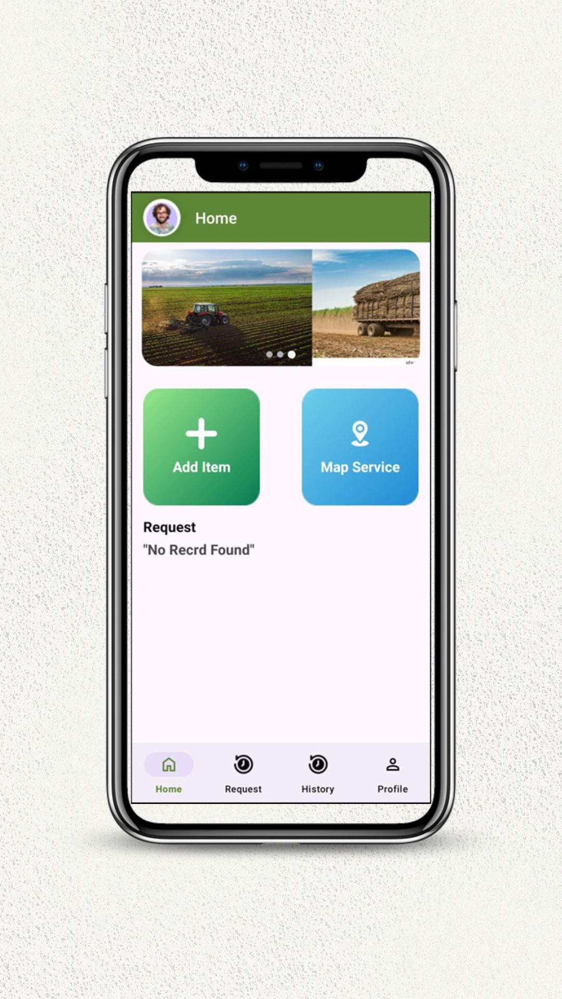
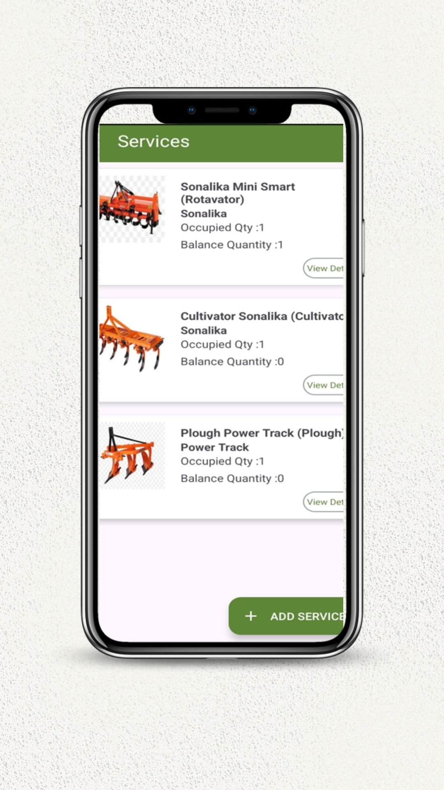
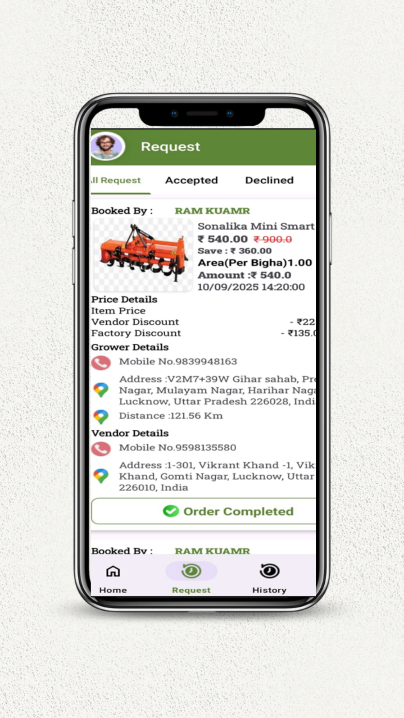
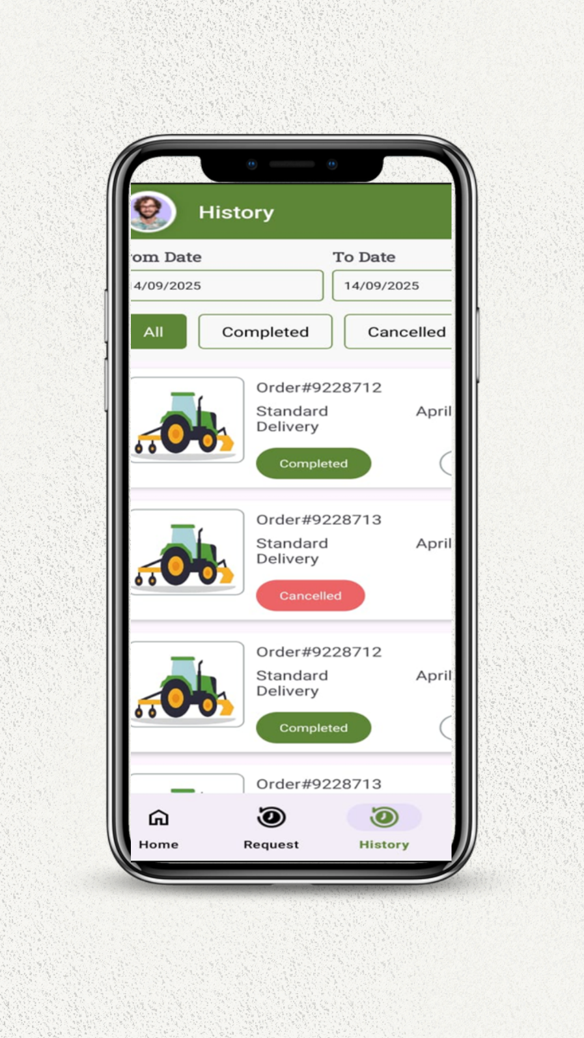
CANE MECHANISATION APP
Vendor App

Slide 14
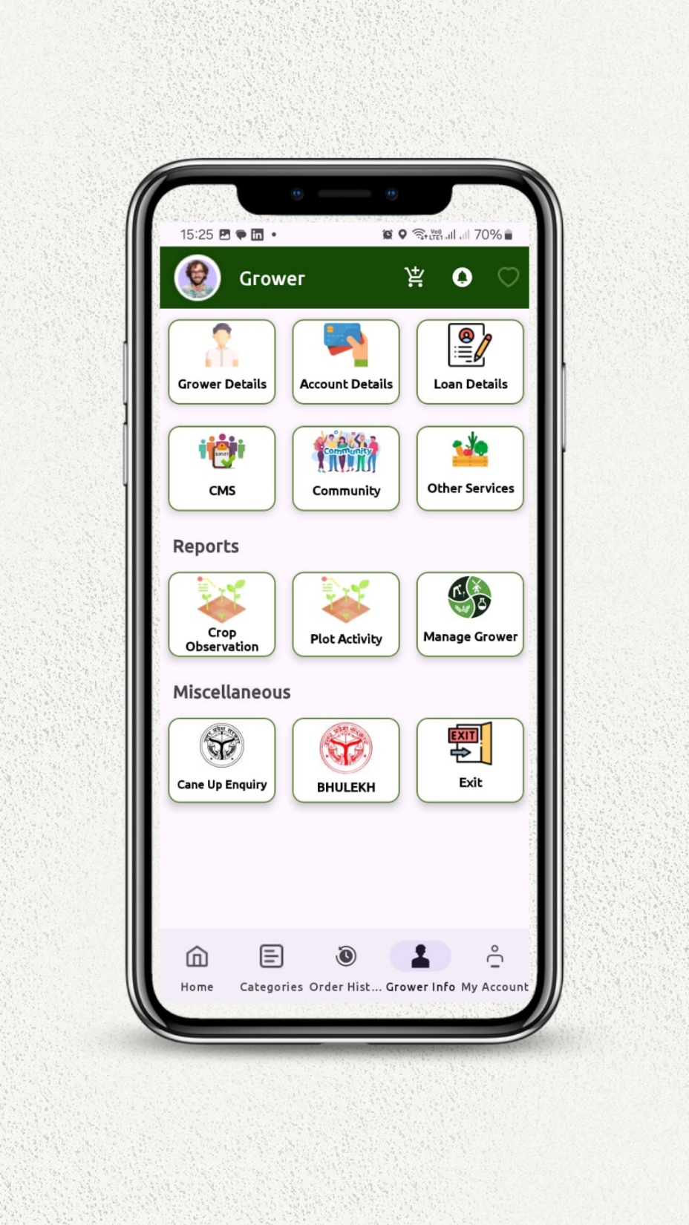

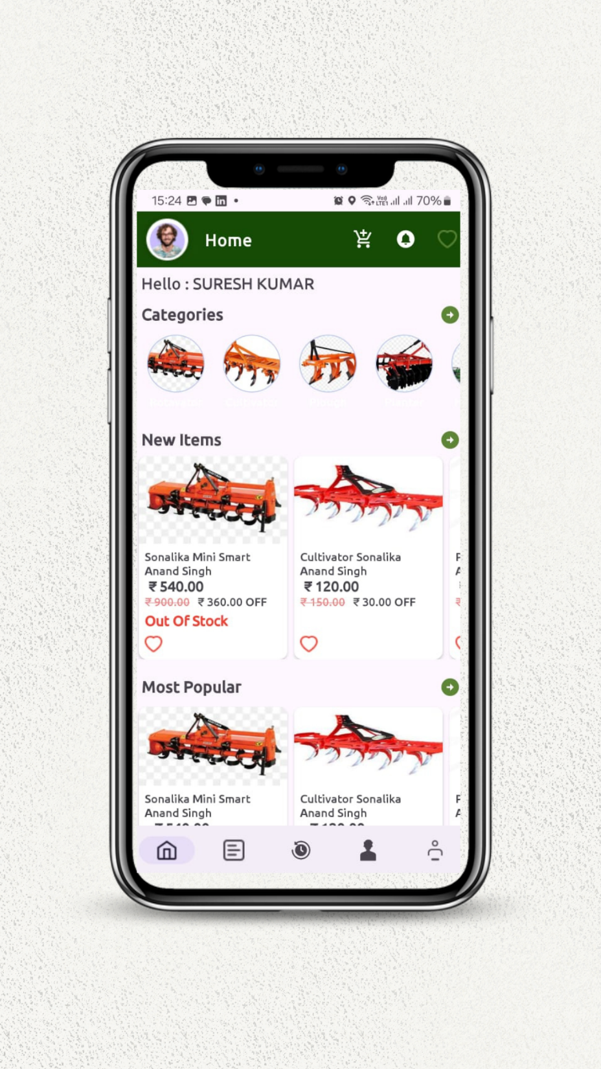
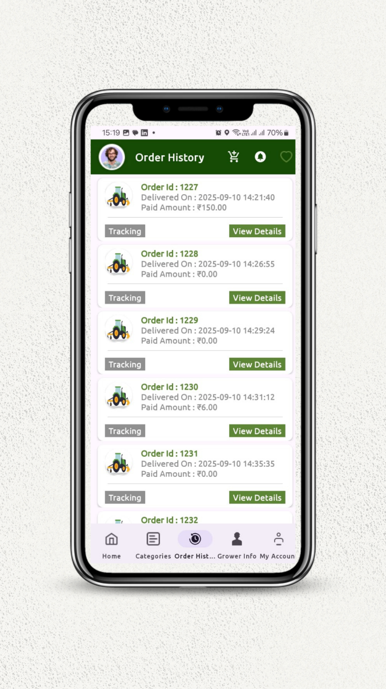
CANE MECHANISATION APP
Grower App

Slide 15
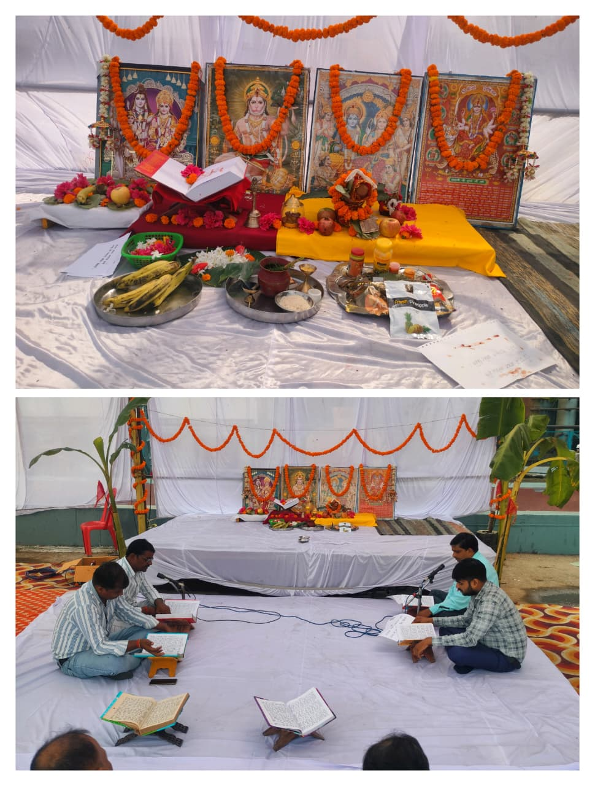
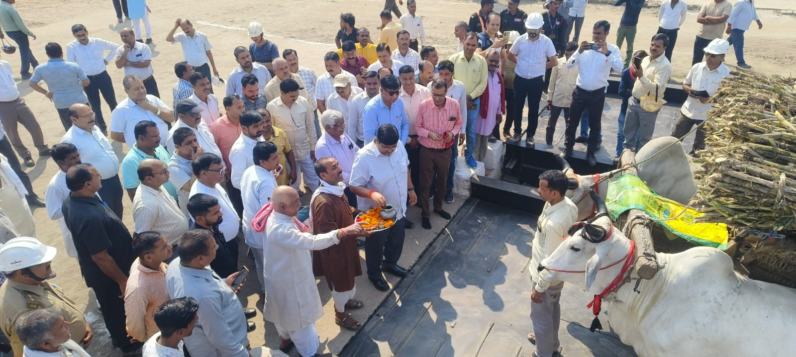
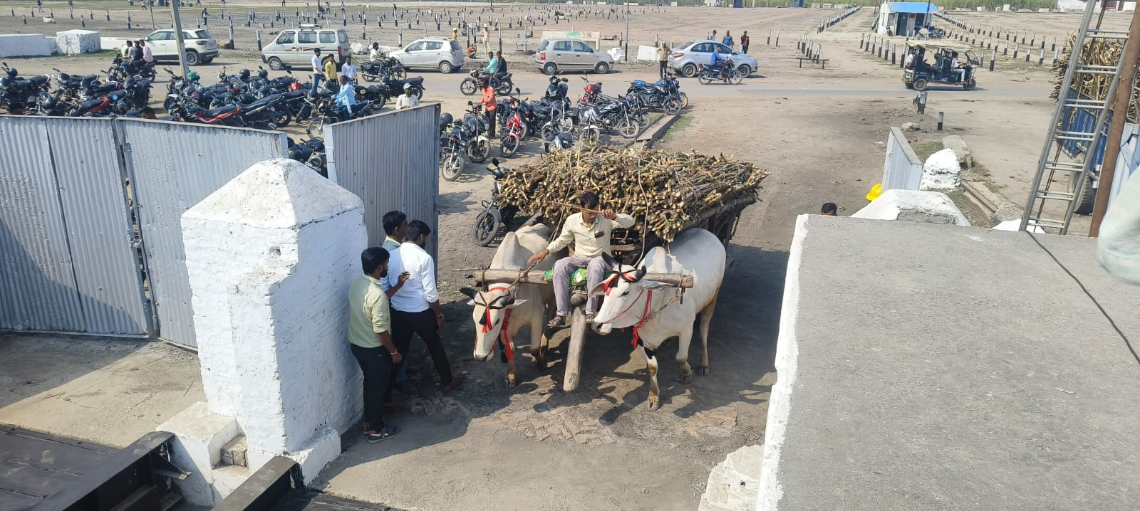
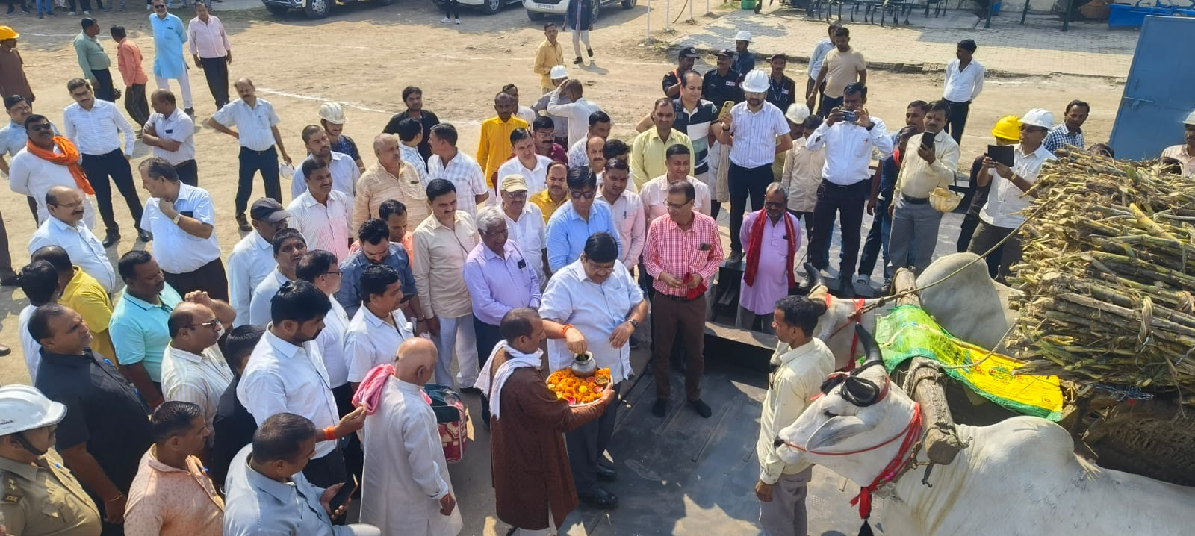
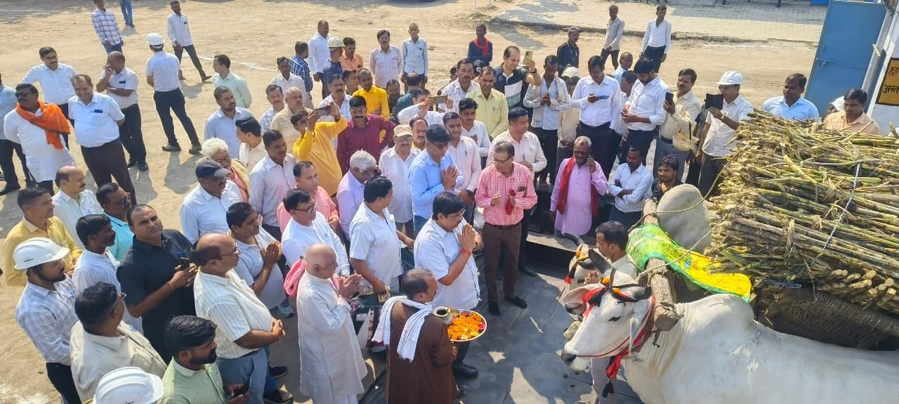
Donga Pooja

Slide 16
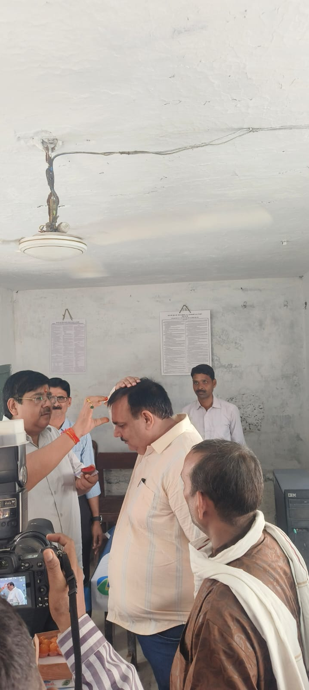
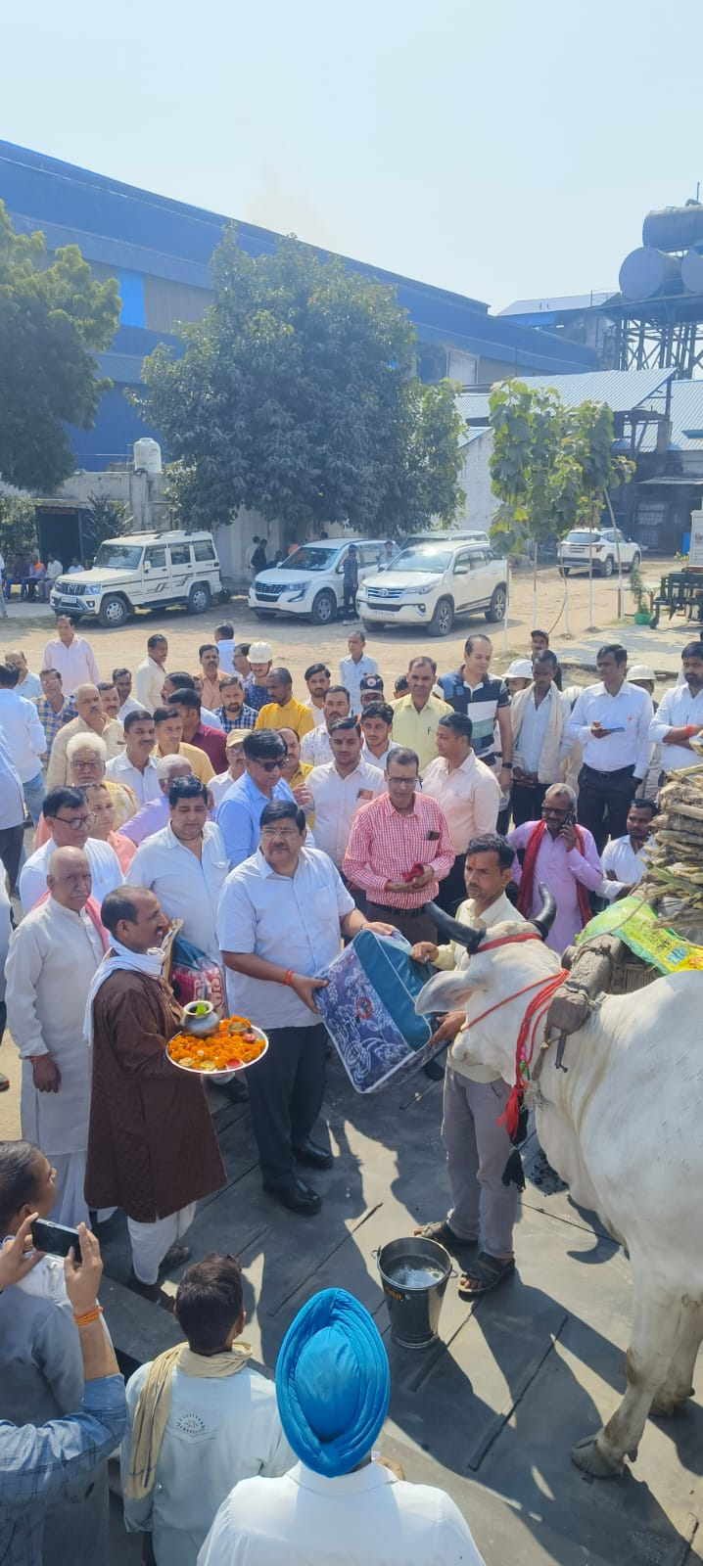
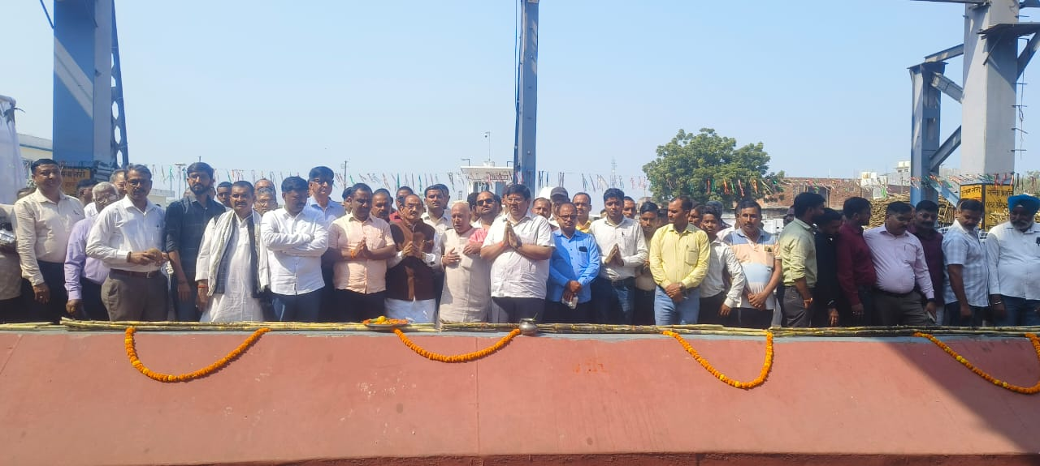
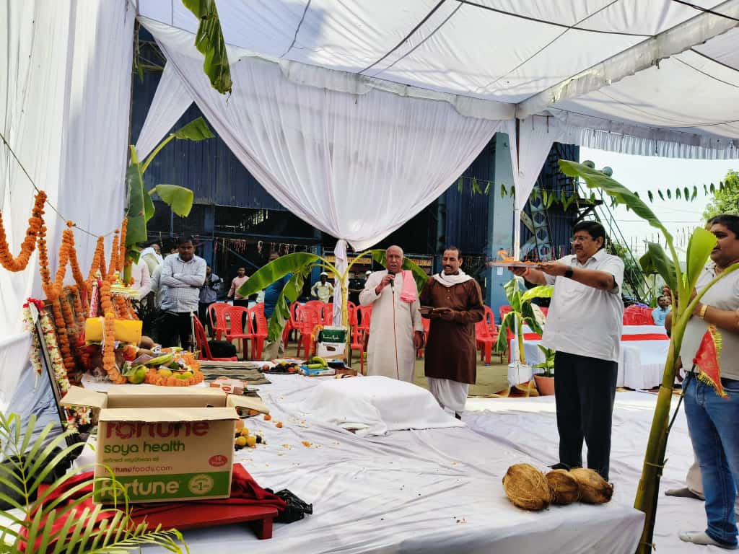
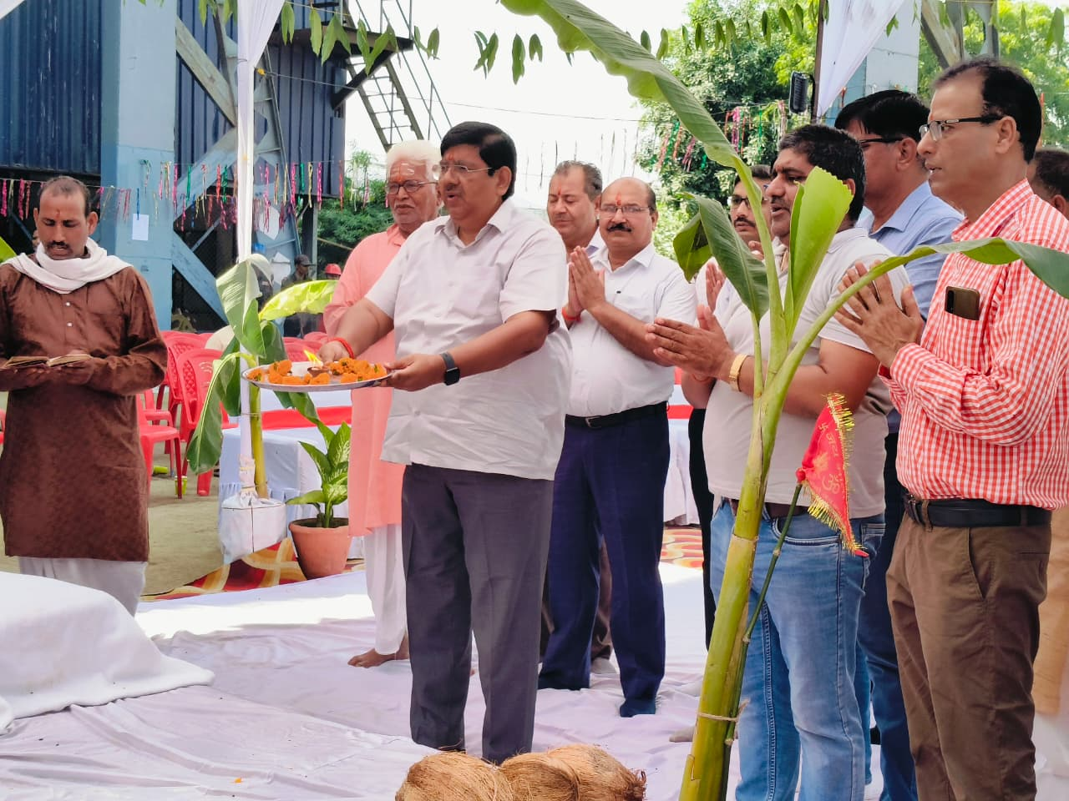
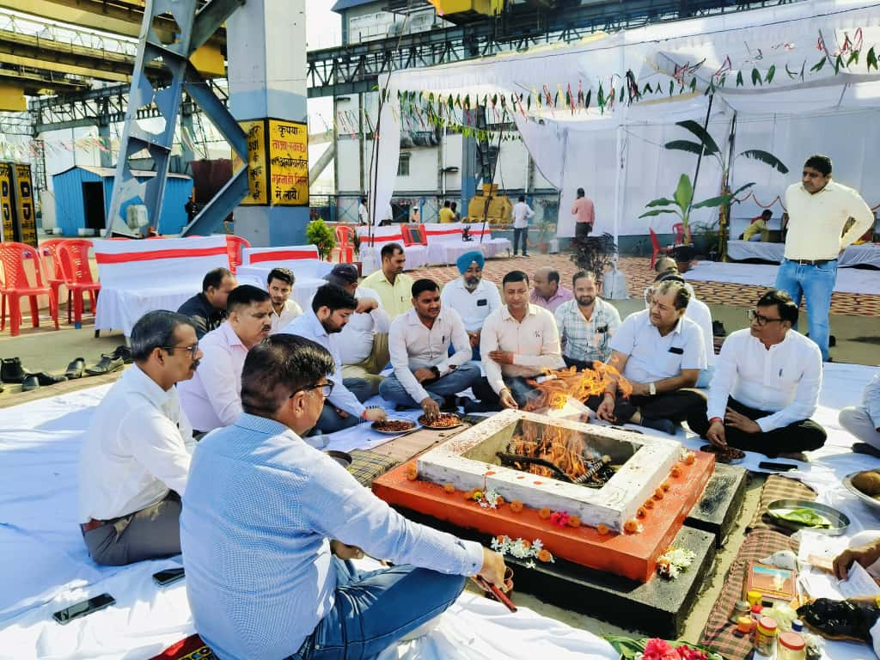
Donga Pooja

Slide 17
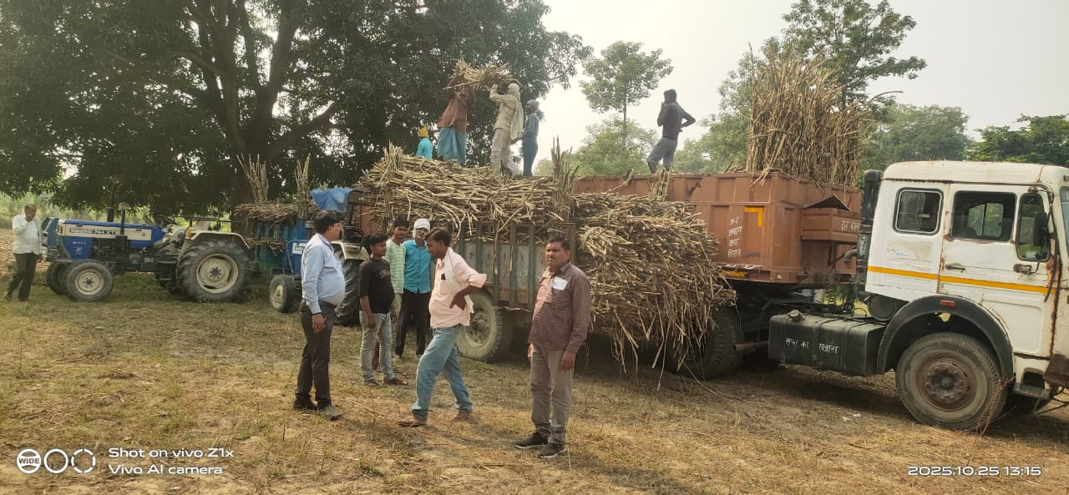
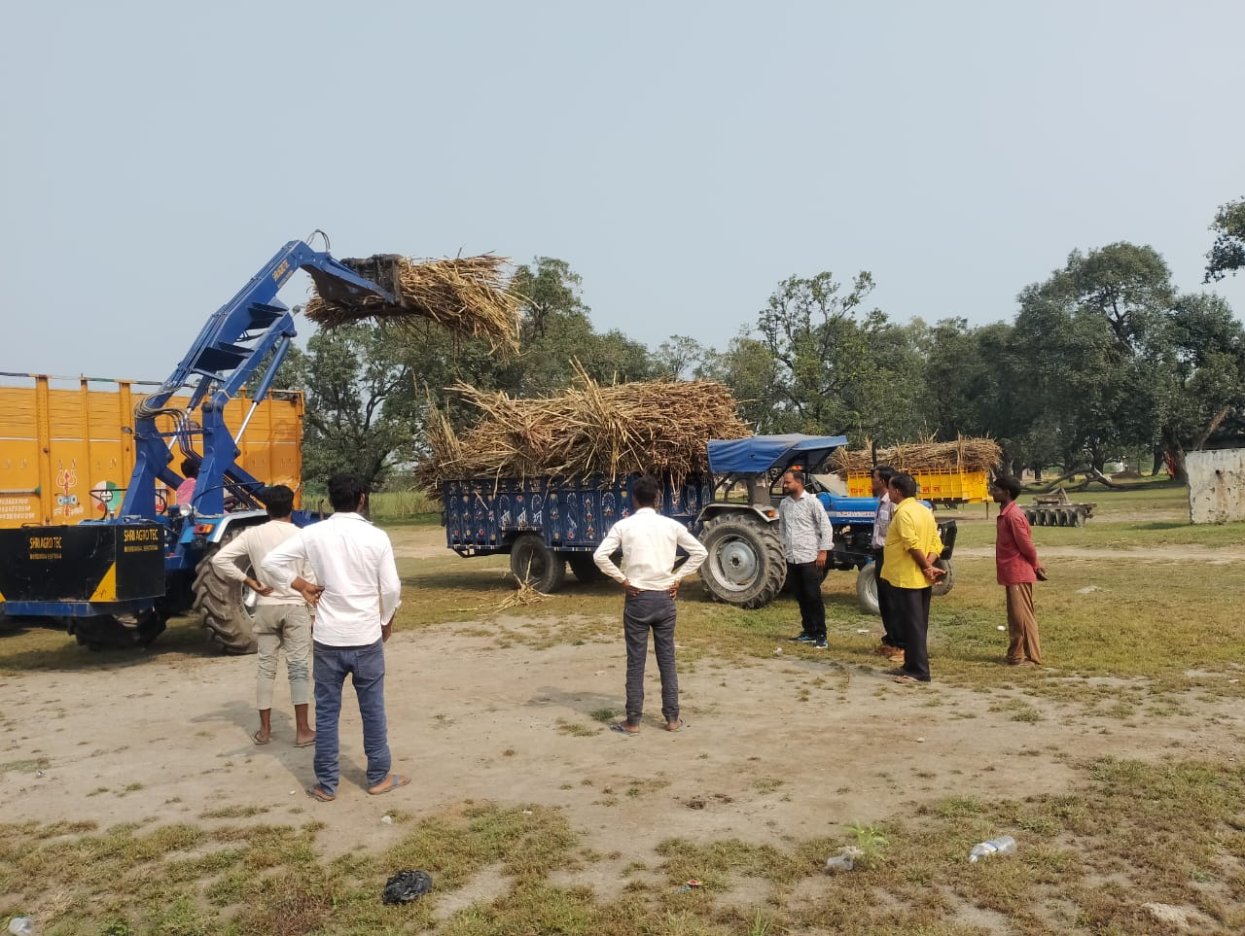
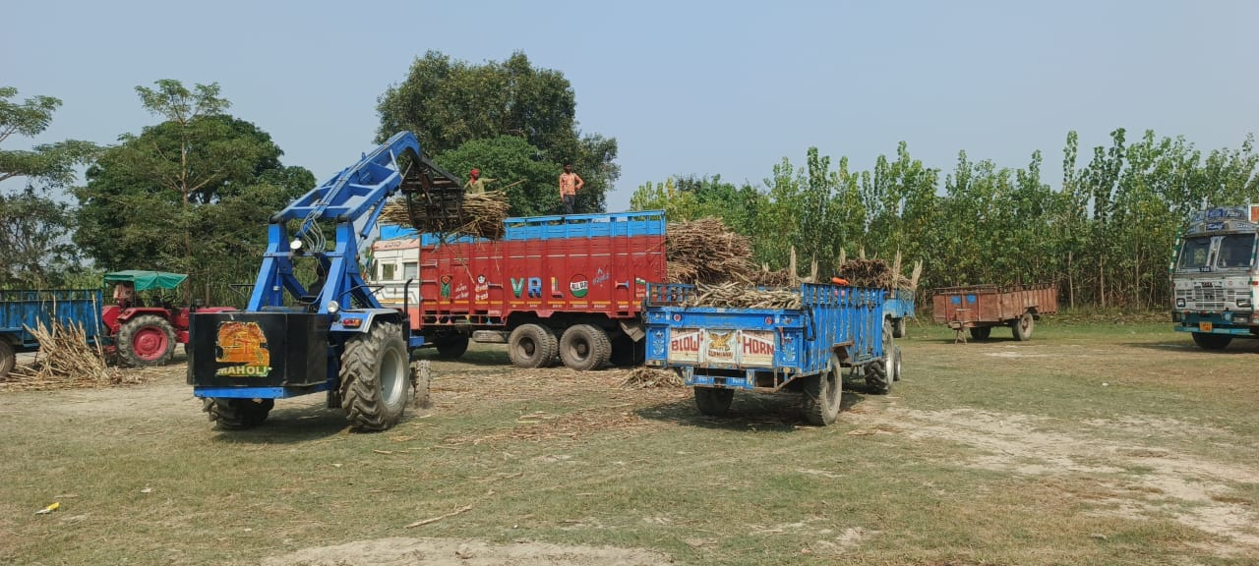
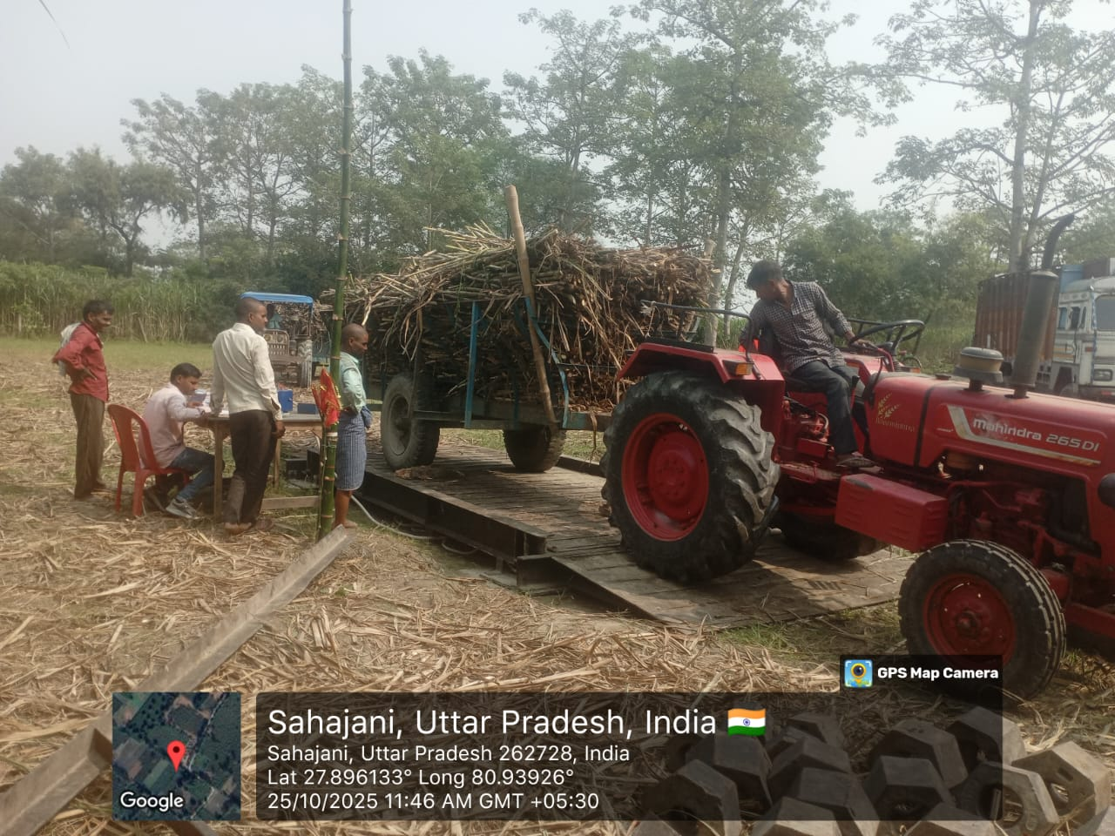
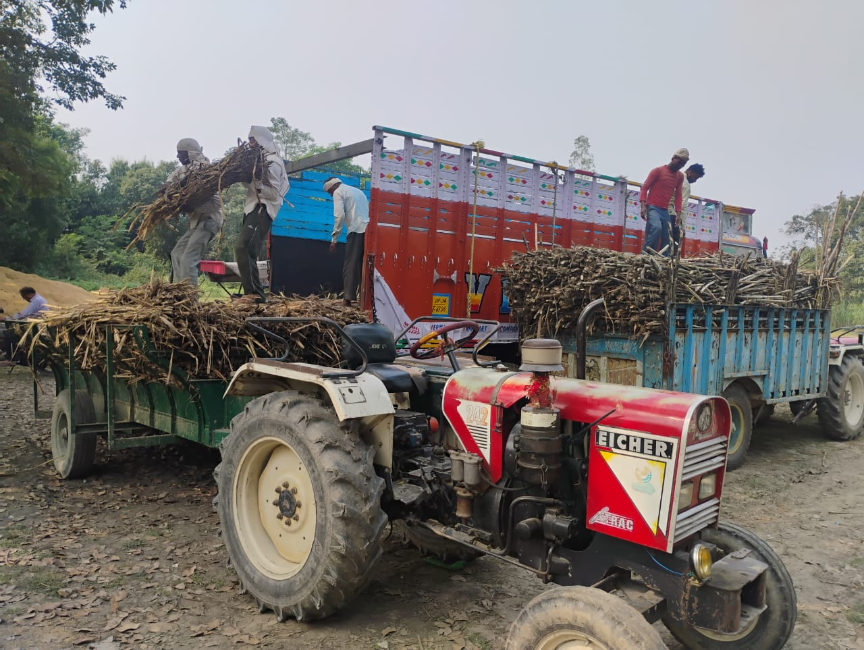
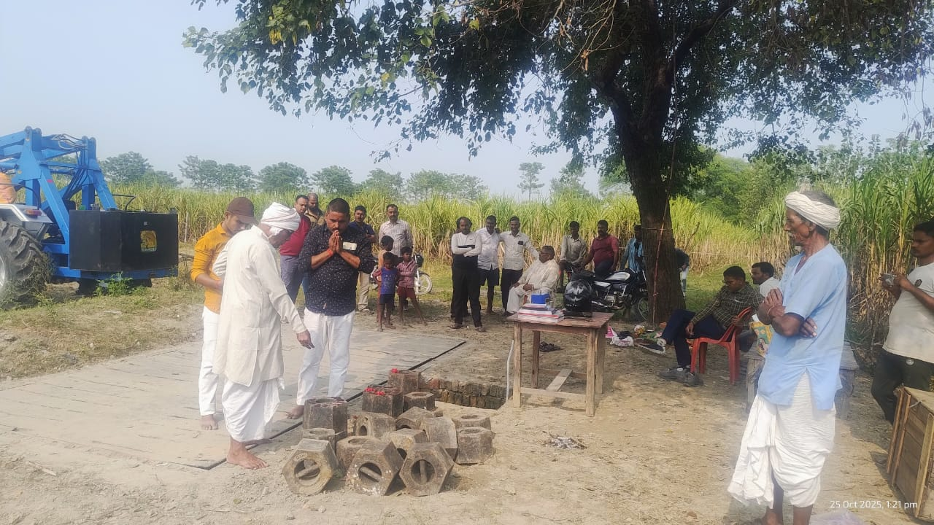
CANE PURCHASE AT THE CENTRE

Slide 18
Saksham App
Additional features activated on Saksham App
Attendance
Movement tracking of field staff, location mapping and mileage
Autumn indenting and Seed reservation
Seed mapping
Crop observation
Village meeting
Flood reporting
Soil Sample collection and reporting- 776 samples planned for autumn season

Slide 19
Autumn Planting Target 2025-26

Slide 20
Pests and Diseases up to 25.10.2025
Action Taken
Pyrilla :_ Incidence level negligible due to rain.
Top Borer:- Incidence level is low. For control of third brood Coragen drenching as per recommendation
Root Borer:- As per advice by Dr. Manager Singh Mechanical shoot cutting in affected plant then use of imidacloprid drenching after irrigation.
Smut:- Mechanical control undertaken in affected plot.

Slide 21
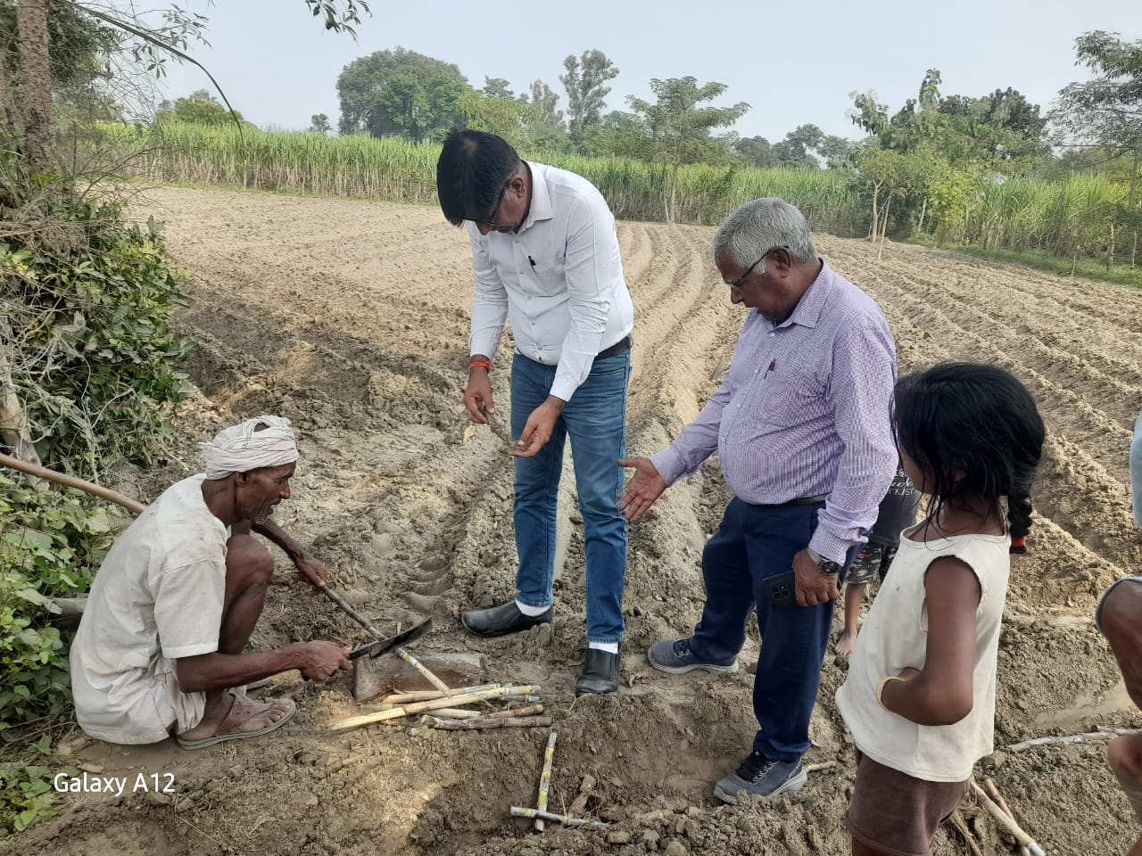
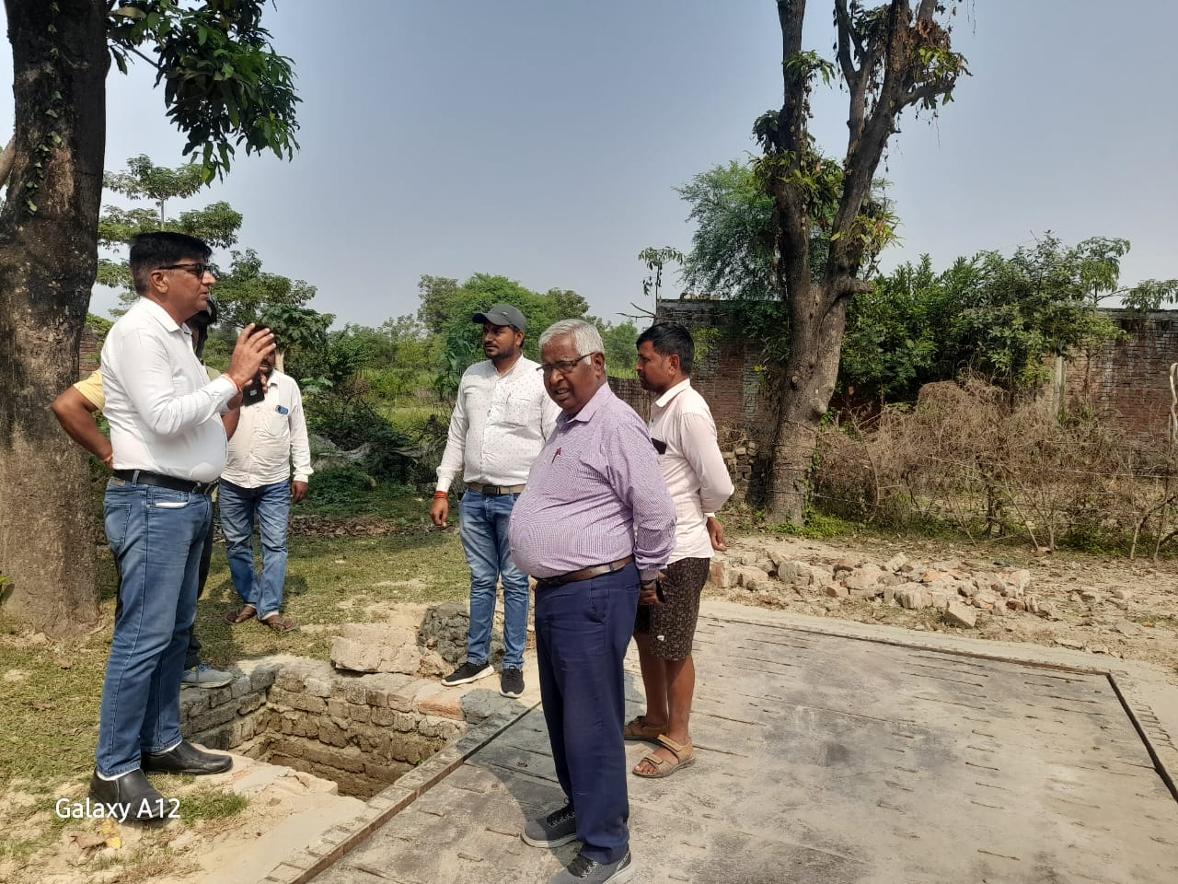
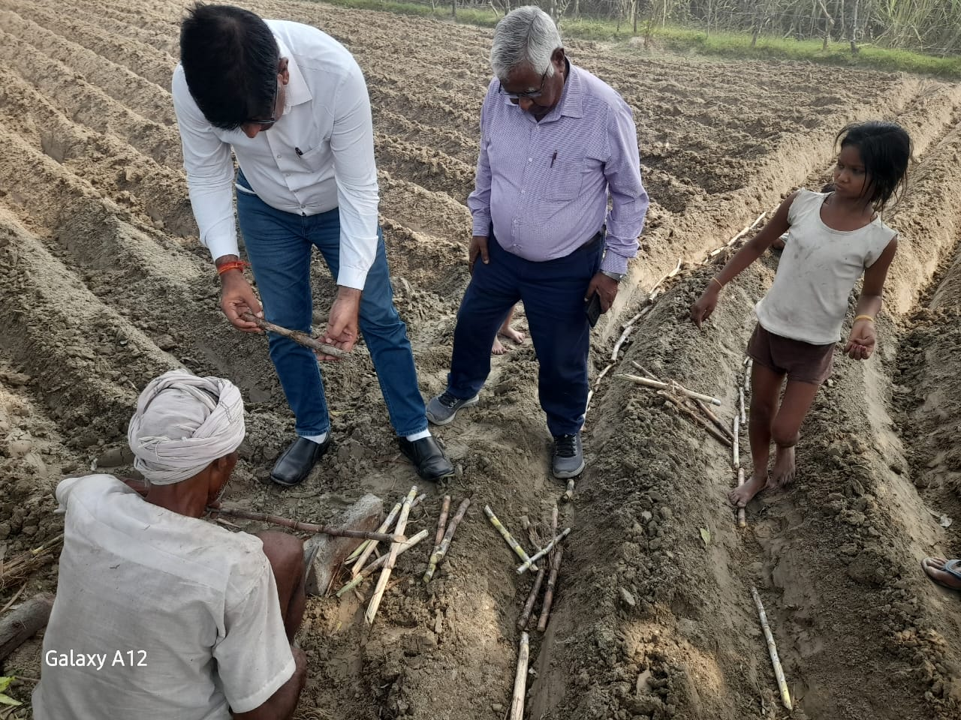
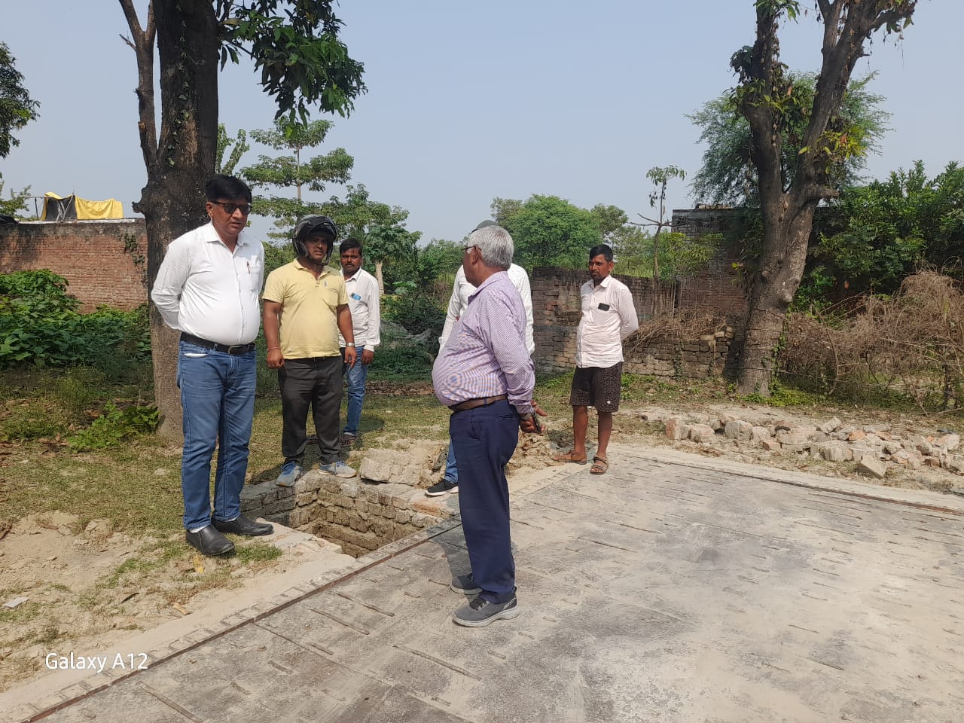
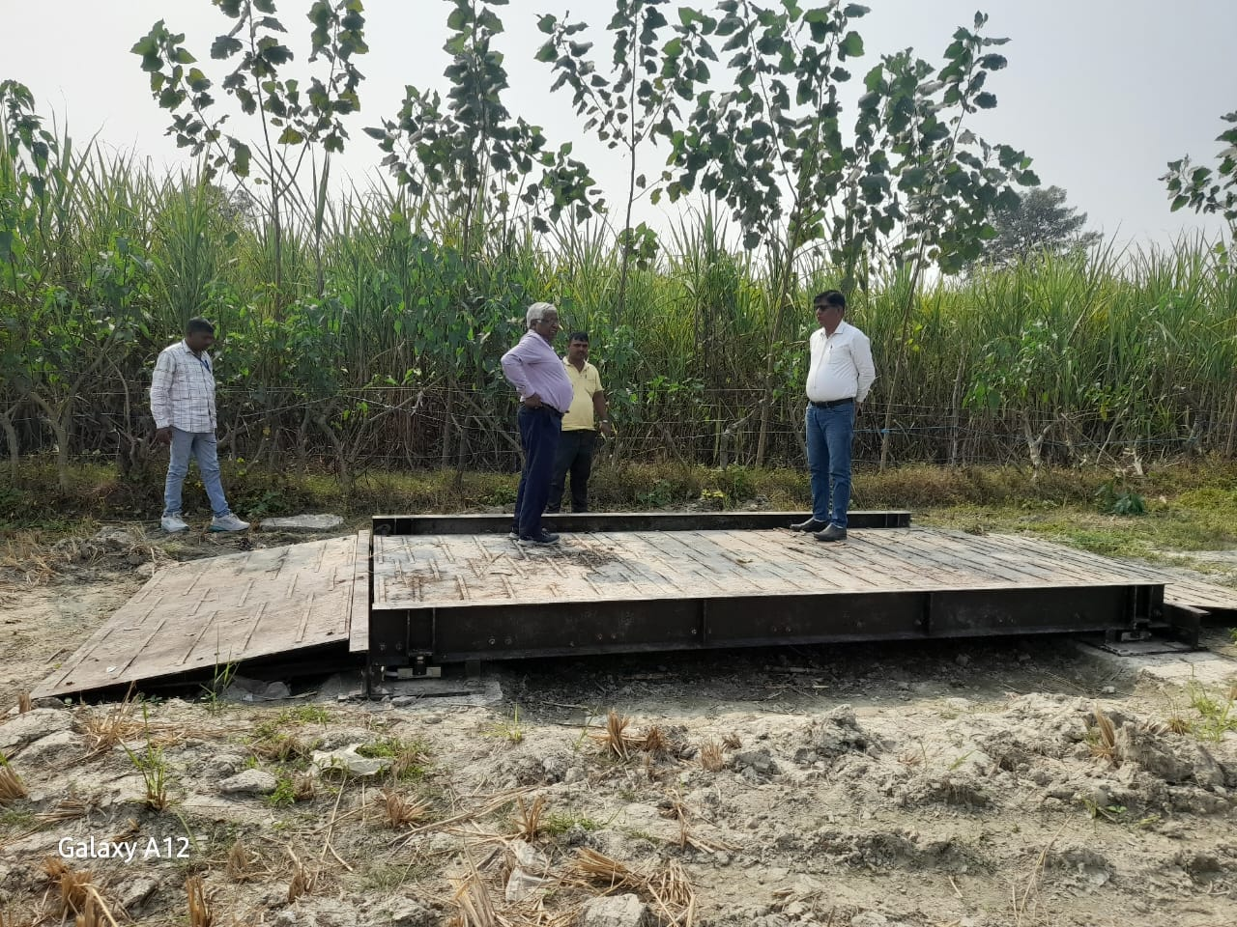
AGRI EXPERT VISIT: OCTOBER- 2025

Slide 22
AGRI EXPERTS VISIT: OCTOBER- 2025

Slide 23
KOLHU AND CRUSHERS RUNNING & CRUSHING REPORT
Particulars | Total (No’s) | Rate/ Qtl. (Rs.) | Running (No’s) |  | Crushing (Qtls.) |  | Recovery (%)
 |  |  | This week | To Date (up to 25.10.25) | This week | To Date (up to 25.10.25)
Kolhu (50) | 192 | 295-310 | 20 | 55 | 7700 | 21175
Crushers | 15

Slide 24
FLOOD AFFECTED

Slide 25
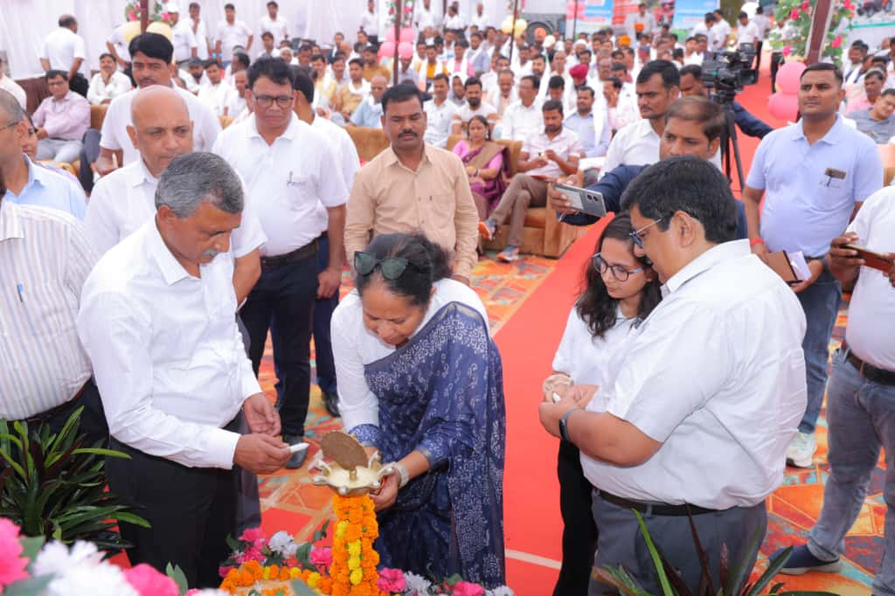
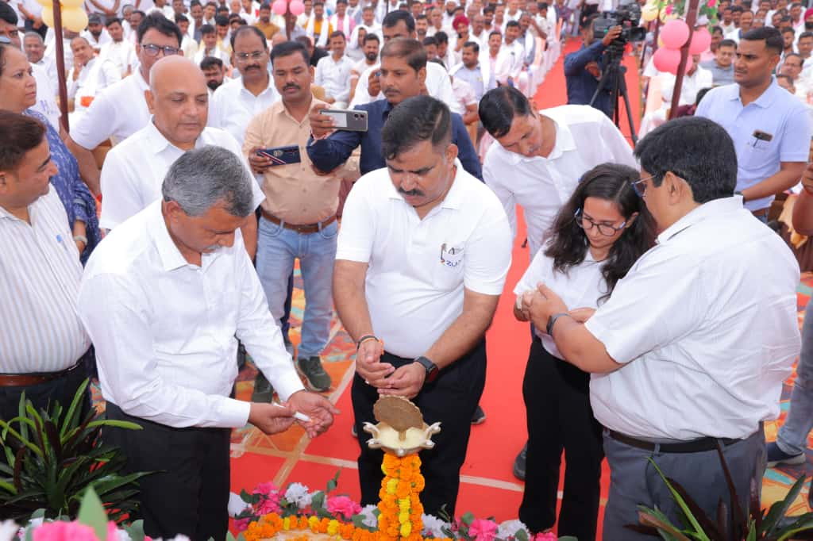
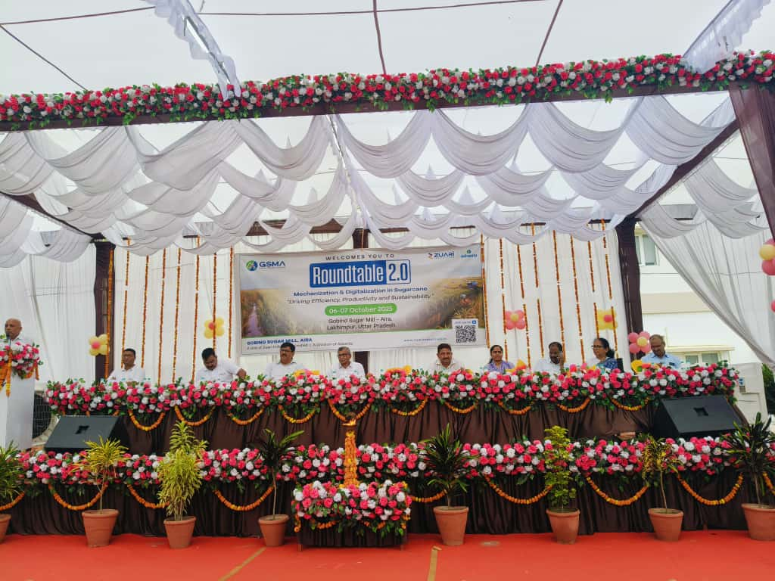
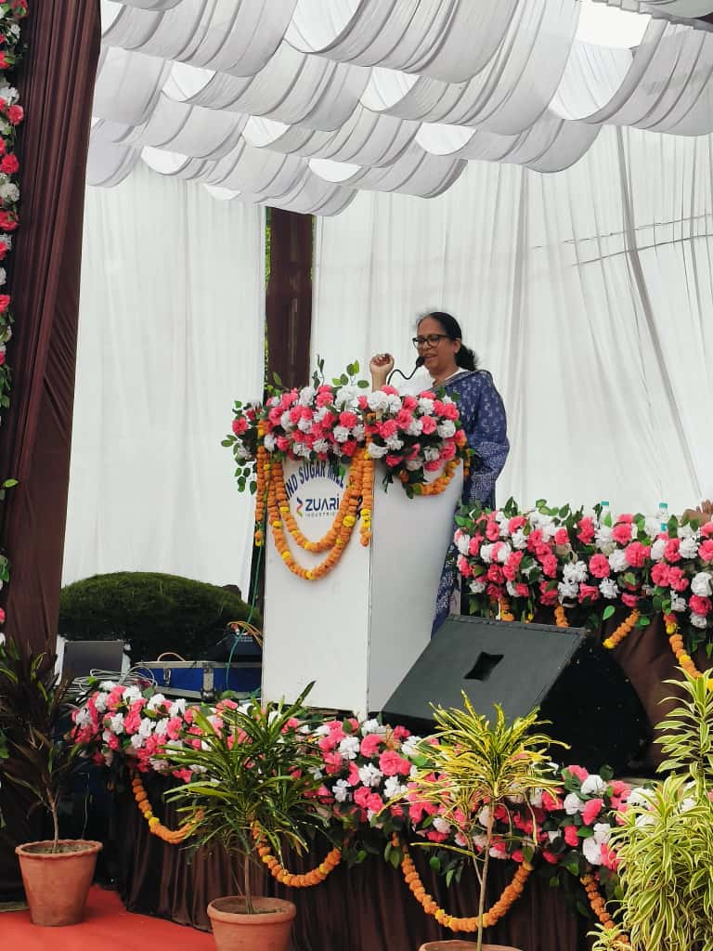
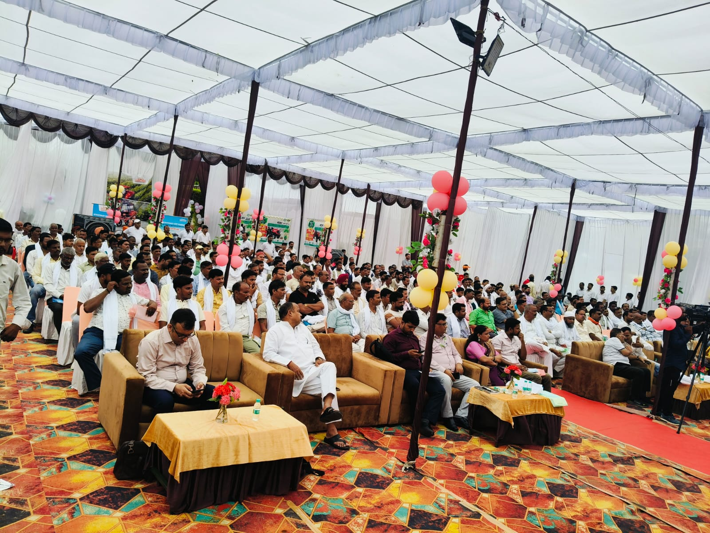
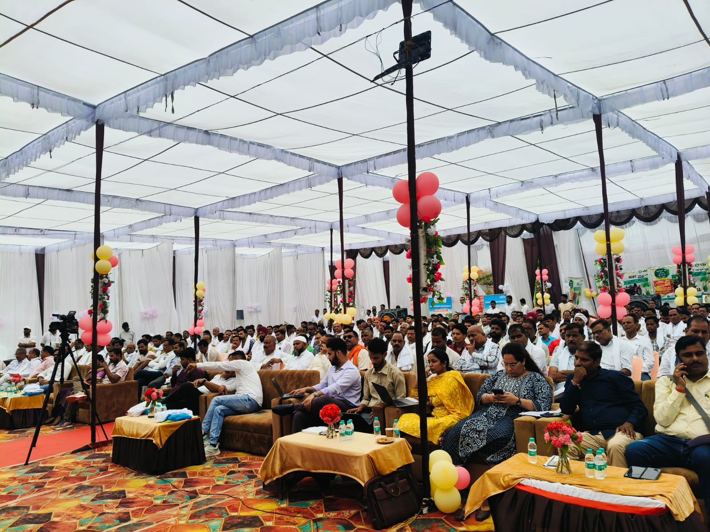
Roundtable 2.0

Slide 26
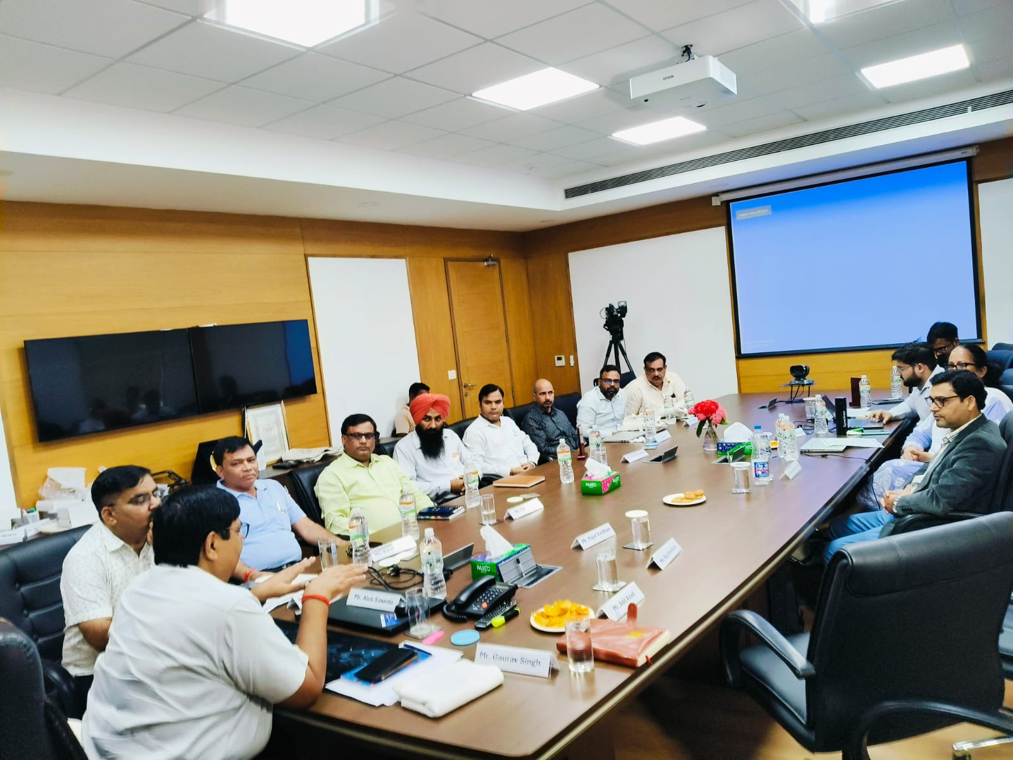
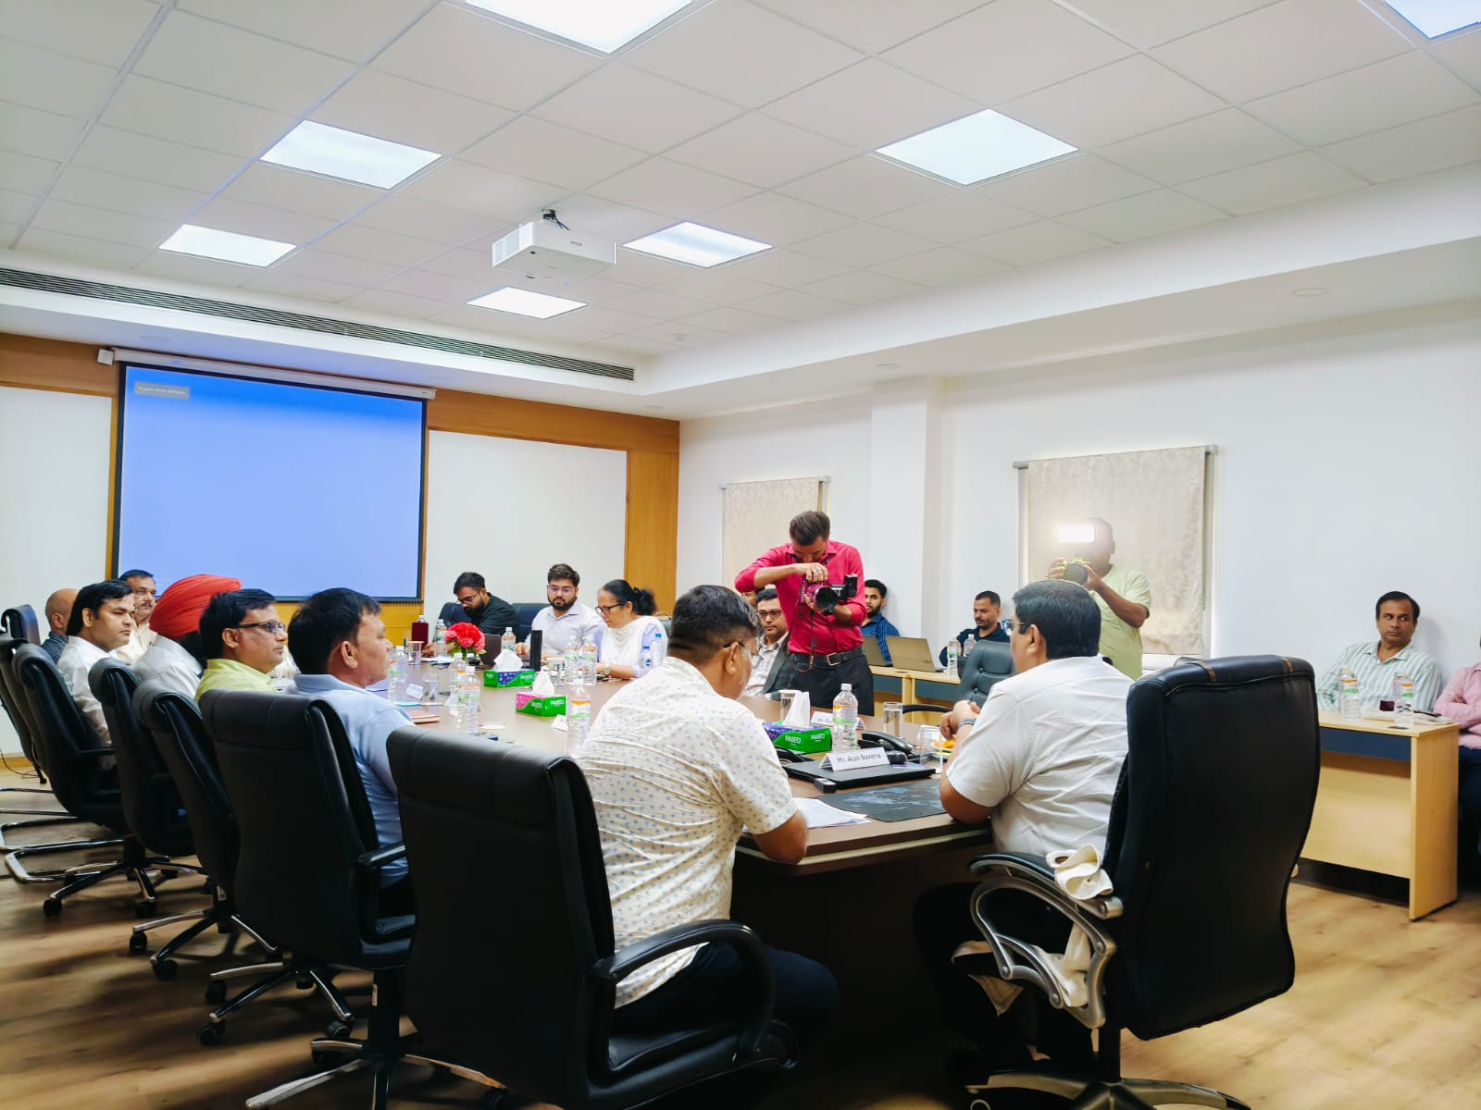
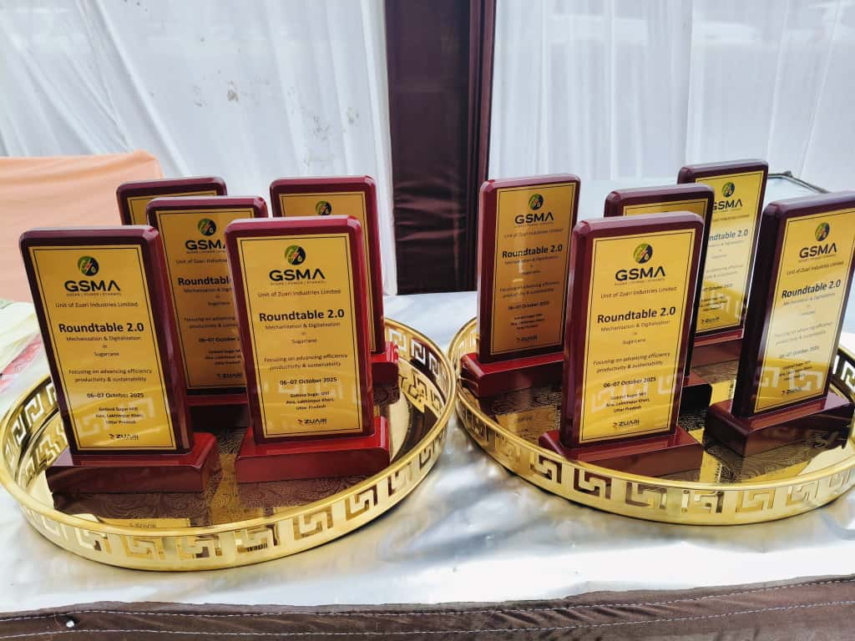
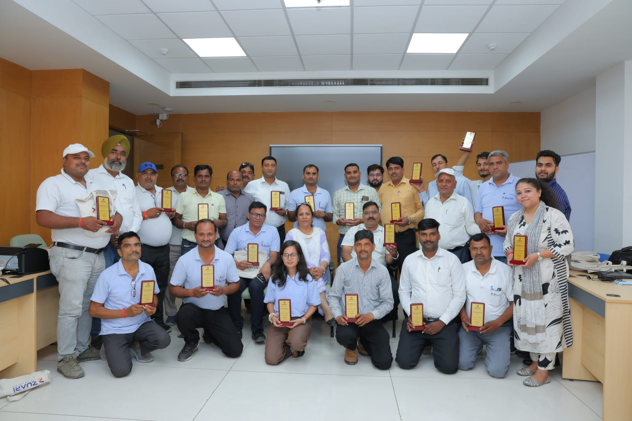
Roundtable 2.0

Slide 27
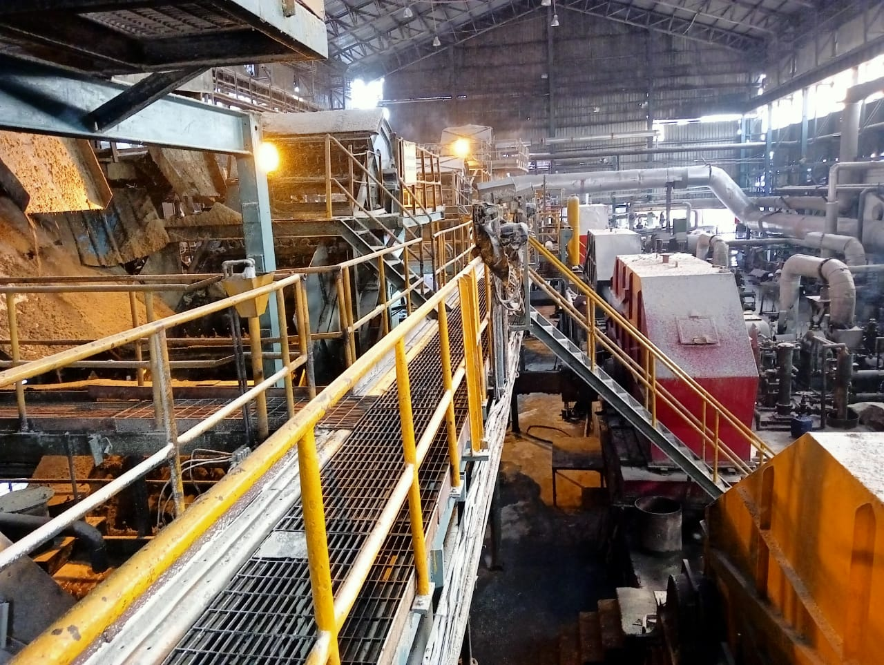
ENGINEERING

Slide 28
General Plant Observations of The Week
ACC, MCC, CD & Shredder carrier gear boxes damage parts replaced & Trial done
Mill No 1: 120 Teeth gear received on 18.10 & replaced on 20.10.25
Mill No 3: 86 Teeth gear received on 18.10 & replaced on 20.10.25
Mill No 4: 86 teeth gear not received till date. Existing gear are repaired and SR done.

Slide 29
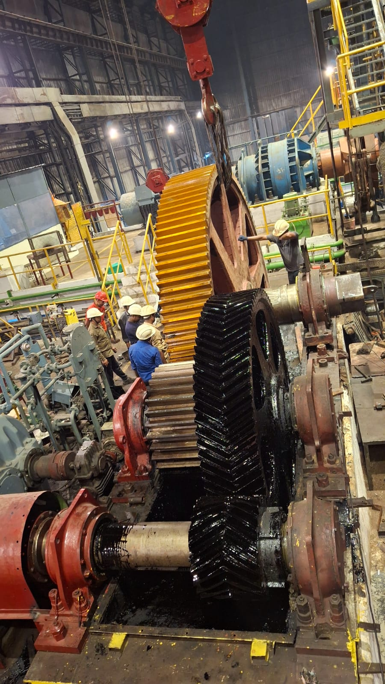
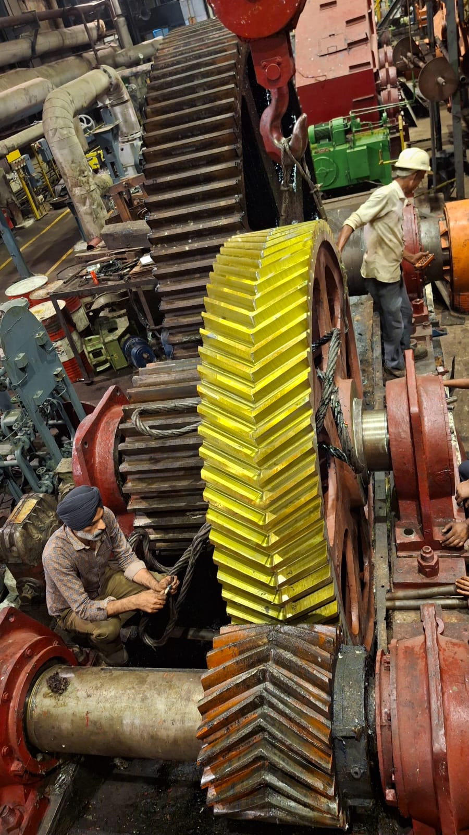
General Plant Observations of The Week
Mill No 1: 120 Teeth Gear Replaced
Mill No 3: 86 Teeth Gear Replaced

Slide 30
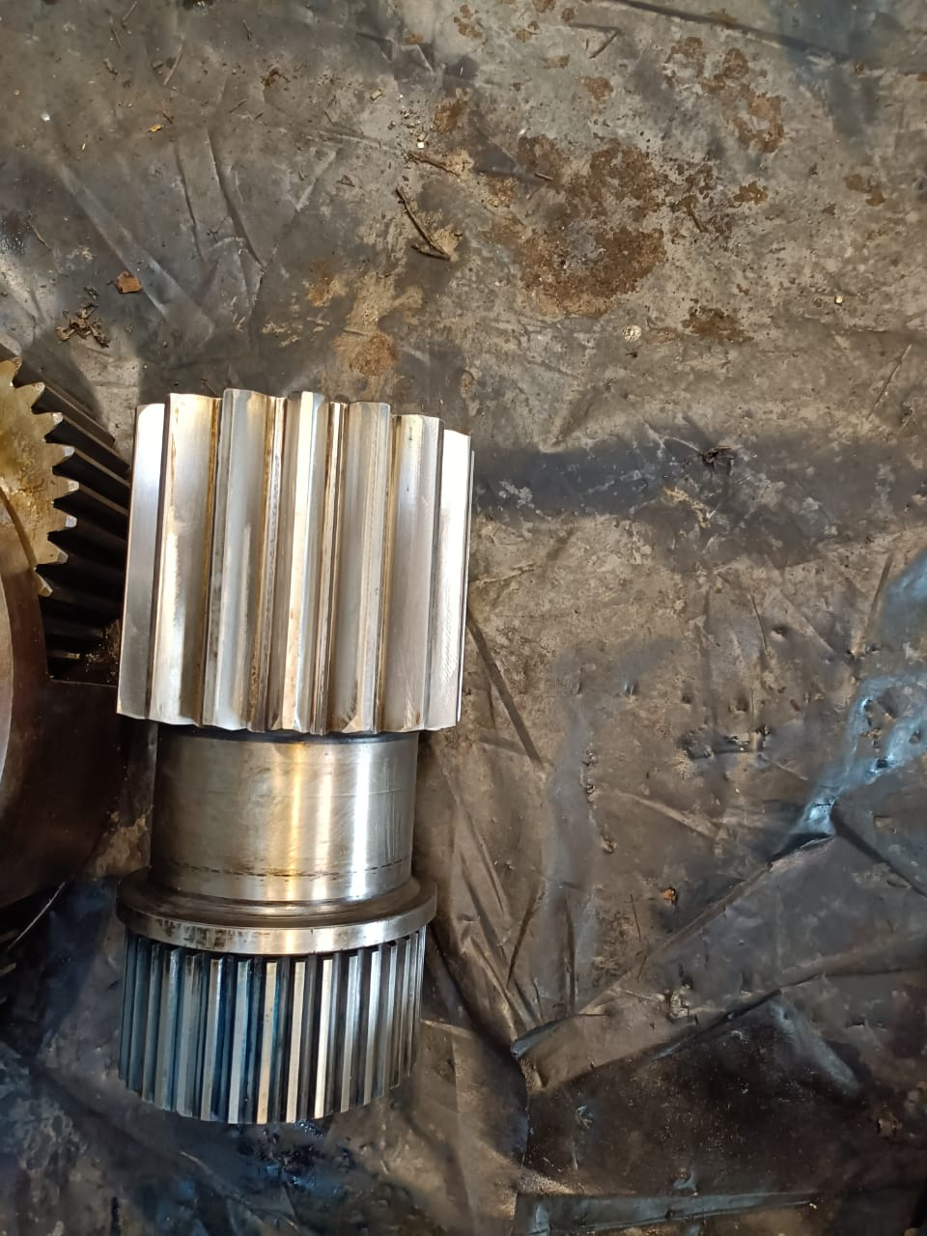
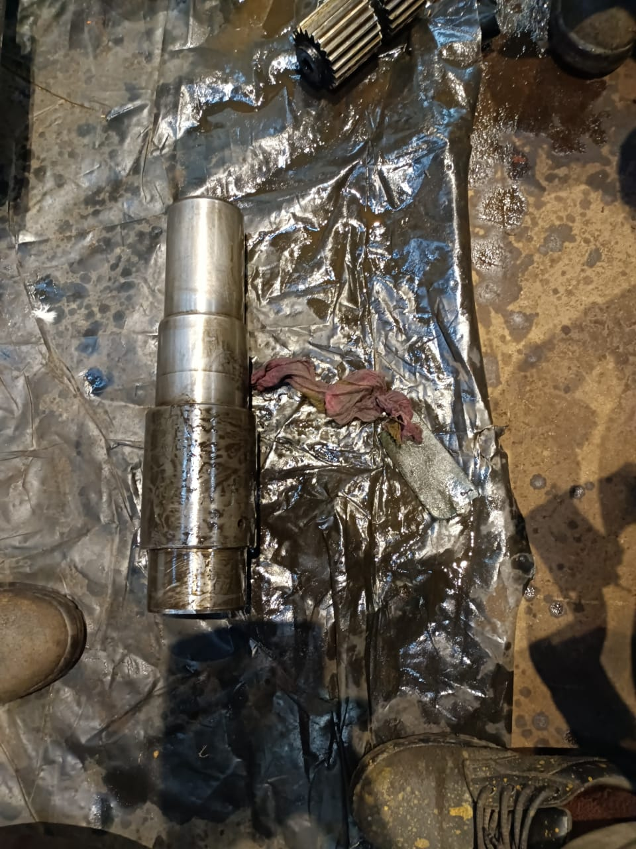
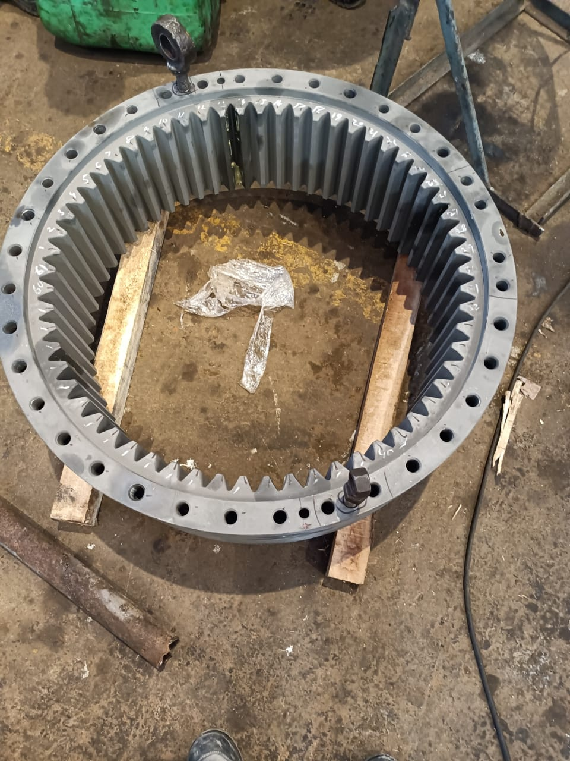
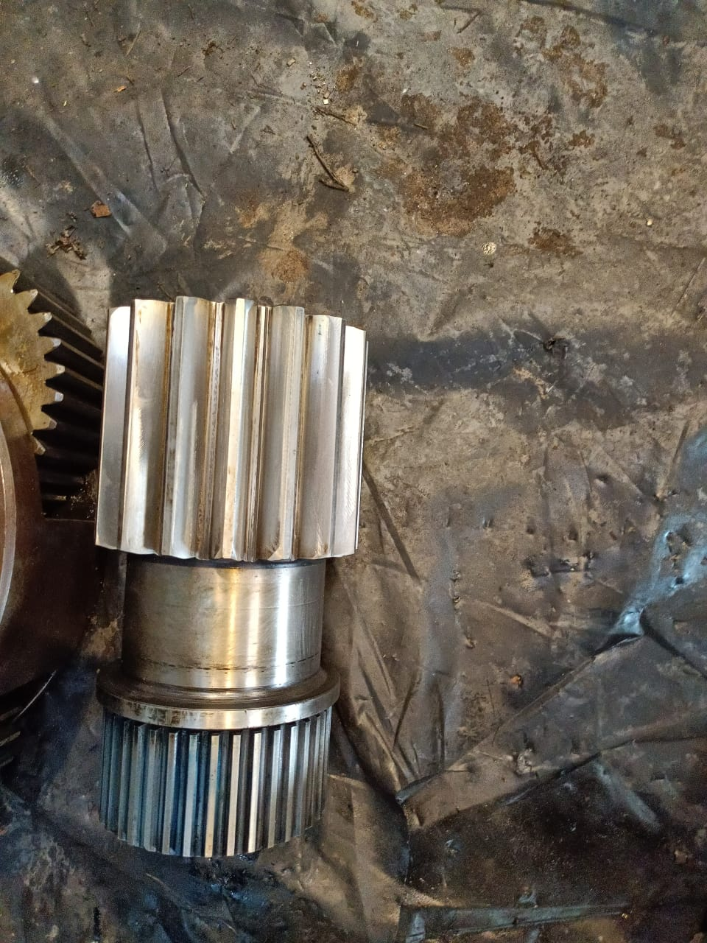
MCC & Shredder Rake Carrier Gear Box Overhauling work
MCC & Shredder Rake Carrier Gear Box spare Material received 10.10.25 & damage parts replaced.

Slide 31
Boiling House General Plant Observations of The Week
DS- Clarifier- Worn-out shell replacement work completed including correction of Mud Ring, Provision of bottom guide support. Trial Completed. (MS Plate rec’d on 23.07.25)
Vertical crystal – DS- Coil Fab. & Erection Completed on 07.10.25 & Trial done.
RS-12 nos Coil Replacement work Completed. Trial done.
(Complete bends Received on 19.09.25-875 Nos)
Pan Discharge Valve: P7 & P11: Old valve replaced with pneumatic valve (Received on 05.09.25) Massecuite Pumps-02 nos. pumps replaced with zero leak pumps. (Received on 16.09)
R1& R2 Pump - Pipe line erection work completed.
Damage baskets: Both1750 fitted, and 01 Ton also fitted. (Rec’d on 30.09)
DS Vert Cryst drive: one shell drive replaced.(Received on 10.10.25)
Vibration observed in 1 Ton Machine & checking is U/P
Old 1750 control panel found damage during trial. New will be received by 28.10.25

Slide 32
Plant Reliability: Major Jobs Status
S No | Equipment | Planned | Status | Remarks
1 | Can Unloader No-1 & 6 | Conversion of Mechanical Hoist to Hydraulic motion of Cane Unloader 1st & 6th. | Deferred
2 | MCC | 3rd Stage sun gear & Ring gear to be replaced | Material Received on 10.10.25, Replaced & trial done | Completed
3 | Spare ACC/MCC | 3rd stage Planet (02 nos.) teeth found partial chip off & stopper to be replaced | Material Received on 13.10.25, Replaced & trial done | Completed
4 | Cardin Drum | 2nd stage sun gear some teeth found partial chip off, Gear To Be Replaced | Material Received on 15.10.25, Replaced & trial done | Completed
5 | SRC | 3rd Stage sun gear teeth chip off, Gear to be Replaced | Material Received on 10.10.25, Replaced & trial done | Completed
6 | Transmission Gear Mill No-1 | Replacement of 120 Teeth Gear after receipt of New gear from Gear India for Mill No-1 | Material Received on 18.10.25, Replaced | Completed
7 | Transmission Gear Mill No-1 | Replacement of 32 Teeth pinion after received of New pinion from Gear India for Mill No-1 | Material Received on 10.10.25, Kept as spare | Completed
8 | Transmission Gear Mill No-3 | Replacement of 86 Teeth Gear after received of New gear from Srinathji for Mill No-3 | Material Received on 10.10.25, Replaced | Completed
9 | Transmission Gear Mill No-4 | Replacement of 86 Teeth Gear after received of New gear from Srinathji for Mill No-4 | Initial Teeth cutting done | Delivery Delayed, Exp by Oct End
10 | Transmission Gear Mill No-4 | Replacement of 23 Teeth Pinion after received of New pinion from Srinathji for Mill No-4 | Material Received on 10.10.25, Kept as spare | Completed

Slide 33
Plant Reliability: Major Jobs Status
S No | Equipment | Planned | Status on | Remarks
11 | 1 Ton C/F Machine Basket DS House | 1 ton C/F Machine Basket Repairing & Balancing (Got Damage during Transportation) | Received on 30.09, Installed & Trial Done
12 | 1750 C/F Machine Basket Raw House | 1750 C/F Machine Basket Repairing & Balancing (Got Damage during Transportation) | Received on 30.09, Installed & Trial Done
13 | 1750 C/F Machine Basket Refinery House | 1750 C/F Machine Basket Repairing & Balancing (Got Damage during Transportation) | Only new bottom hood received on 30.09, Installed & Trial Done | Basket will be received by 15.10.25
14 | RS & DS vert Crystallizer | Coil Replacement (Pipe & bend Replacement ) | Completed | 02.08-83 Nos, 25.08-239 Nos, 12.09-170 Nos, 19.09-389 Nos
15 | DS- B vert Drive replacement | Old drive to be replaced with planetary drive | Received on 10.10.25, One shell drive replaced
16 | 3 MW Load Sync | Load Sync | Completed
17 | A1 Rec Cryst | Damage parts to be replaced | Material Received on 15.10.25, Replaced & trial done

Slide 34
New Shredder Motor Trial Observation 27.09.2025
SHREDDER TRIAL DATA 2024 |  |  |  |  |  |  |  |  |  | SHREDDER TRIAL DATA 2025 |  |  |  |  |  |  |  |  |  | SHREDDER TRIAL DATA 2025 ( with One new Motor & One existing)
Trial Date - 11.10.2024 |  |  |  |  |  |  |  |  |  | Trial Date - 06.09.2025 |  |  |  |  |  |  |  |  |  | Trial Date - 27.09.2025
Shredder Trial Start Time - 10:00 AM |  |  |  |  |  |  |  |  |  | Shredder Trial Start Time - 09:00 AM |  |  |  |  |  |  |  |  |  | Shredder Trial Start Time - 01:30 PM
Shredder Trial End Time - 05:00 PM |  |  |  |  |  |  |  |  |  | Shredder Trial End Time - 04:00 PM |  |  |  |  |  |  |  |  |  | Shredder Trial End Time - 04:30 PM
Total Trial Time - 07 Hrs. |  |  |  |  |  |  |  |  |  | Total Trial Time - 07 Hrs. |  |  |  |  |  |  |  |  |  | Total Trial Time - 03.Hrs.
 |  | L.H.S. |  |  |  | R.H.S. |  |  |  |  |  | L.H.S. |  |  |  | R.H.S. |  |  |  |  |  | L.H.S. |  |  |  | R.H.S.
S.N. | Time | Bearing Temp. | Vibration |  |  | Bearing Temp. | Vibration |  |  | S.N. | Time | Bearing Temp. | Vibration |  |  | Bearing Temp. | Vibration |  |  | S.N. | Time | Bearing Temp. | Vibration |  |  | Bearing Temp. | Vibration
 |  |  | H | V | A |  | H | V | A |  |  |  | H | V | A |  | H | V | A |  |  |  | H | V | A |  | H | V | A
1 | 10:00 AM | 39 | 0.9 | 0.6 | 3 | 38 | 1.4 | 1.1 | 3.57 | 1 | 09:00 | 31 | 0.66 | 0.4 | 1.14 | 31 | 0.48 | 0.51 | 0.99 | 1 | 13:45 PM | 39 | 1.12 | 0.58 | 1.14 | 38 | 1.2 | 0.49 | 1.45
2 | 11:00 AM | 50 | 1.1 | 0.4 | 1.8 | 48 | 0.9 | 0.3 | 1 | 2 | 10:00 AM | 49 | 0.93 | 0.59 | 1.43 | 50 | 0.71 | 0.65 | 1.26 | 2 | 14:45 PM | 54 | 0.98 | 0.44 | 1.06 | 55 | 1.01 | 0.33 | 0.88
3 | 12:00 PM | 54 | 1.19 | 0.77 | 1.91 | 50 | 1.22 | 0.73 | 1.9 | 3 | 11:00 PM | 54 | 0.88 | 0.58 | 1.26 | 55 | 0.62 | 0.62 | 1.31 | 3 | 15:45 PM | 58 | 0.72 | 0.38 | 0.94 | 57 | 0.69 | 0.42 | 0.74
4 | 1:00 PM | 51.3 | 1.1 | 0.95 | 2.96 | 46 | 0.85 | 0.67 | 2.51 | 4 | 12:00 PM | 55 | 0.86 | 0.56 | 1.23 | 56 | 0.56 | 0.6 | 1.28 | 4 | 16:30 PM | 61 | 0.31 | 0.57 | 0.95 | 59 | 0.4 | 0.53 | 0.84
5 | 2:00 PM | 57 | 1.27 | 0.93 | 3.42 | 50.6 | 1.27 | 0.78 | 2.51 | 5 | 1:00 AM | 55 | 0.81 | 0.49 | 0.95 | 57 | 0.5 | 0.49 | 1.05 | 5
6 | 3:00 PM | 59.1 | 1.25 | 0.89 | 3.24 | 52.2 | 1.23 | 0.75 | 2.68 | 6 | 2:00 PM | 58 | 0.78 | 0.48 | 0.92 | 58 | 0.48 | 0.48 | 1.05 | 6
7 | 4:00 PM | 60.1 | 1.25 | 0.88 | 3.16 | 53.5 | 1.25 | 0.73 | 2.72 | 7 | 3:00 AM | 59 | 0.76 | 0.49 | 0.98 | 58 | 0.47 | 0.5 | 1.13 | 7
8 | 5:00 PM | 60.15 | 1.25 | 0.88 | 3.07 | 53.8 | 1.24 | 0.73 | 2.68 | 8 | 4:00 PM | 58 | 0.82 | 0.49 | 1 | 59 | 0.53 | 0.51 | 1.15 | 8

Slide 35
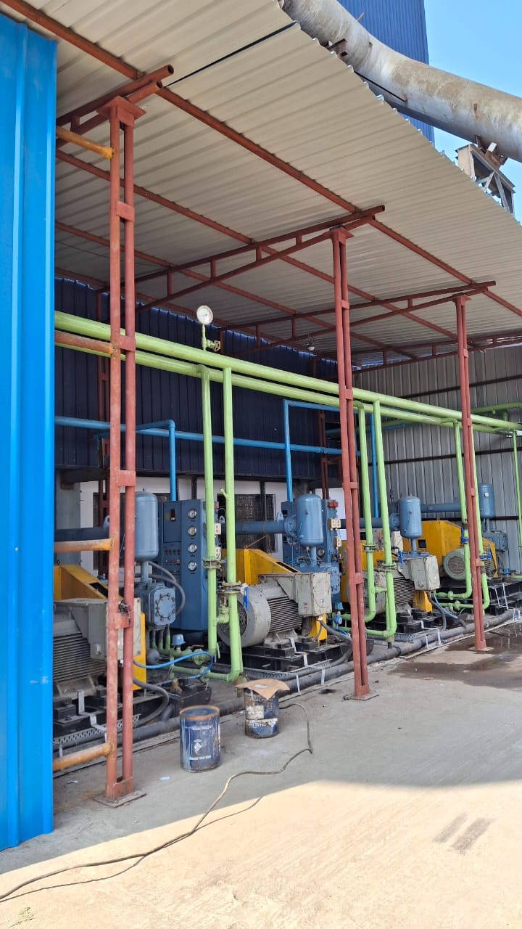
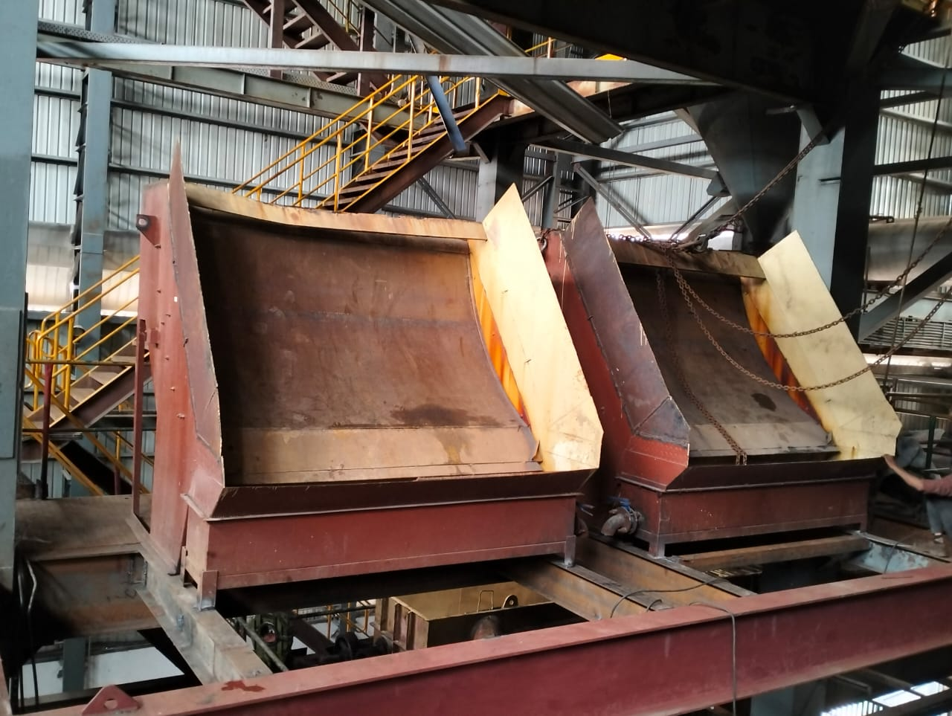
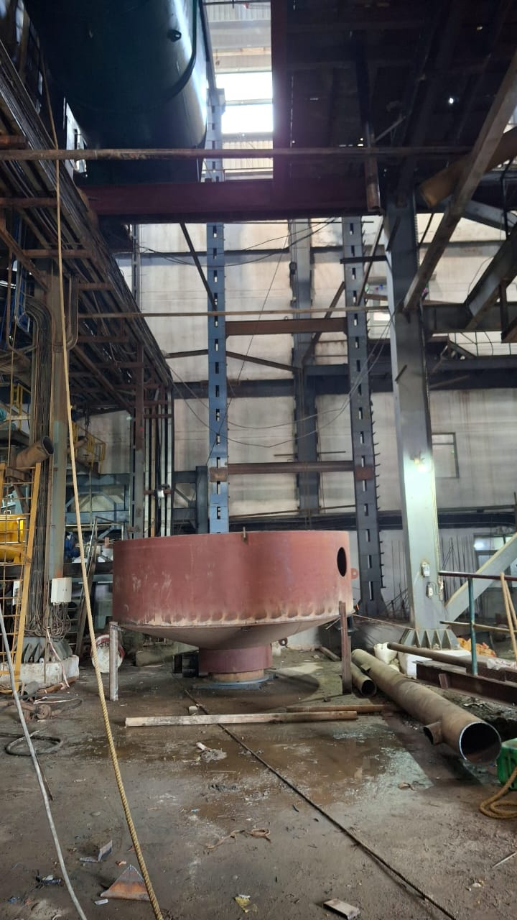
PROJECT JOB(R3 PAN)
1. Compressor Shifting Completed-Trial Done & Shade completed.
2. DSM Screen Work Completed.
3. Crystallizer Placed at Position.
4. Column Erection done and beam erection is Under Progress.
5. Required Connection completed.

Slide 36



Project: DS House Mud Removing System Work Progress
02 Nos. Decanter Received at Site on 07.08.25 & 06 Nos Tanks Received on 20.08.25
Decanter Foundation: Raft Casting completed, Column & tank casting is under progress-

Slide 37
MILL-Capex Status 25-26
S.NO | Project Name | Objective of Project | Budget | PO |  |  |  | Status | Remarks
A | Mills |  |  | No | Date | Vendor | Delivery Date | Date
1 | Mill Roller | New Mill Roller Shaft for 42" x 84" size Mill Complete with shell. | 32.90 | 25001 / 250745,255350/25.07.25 | 07.04.2025 | M/s Jassal Engrs Ludhiana | 20.07.2025/ 20.08.2025 | Drawing sent for machining Work | Spare Roller ( expected by end of Oct 25)
2 | Cane Unloaders | Conversion of Mechanical Hoist to Hydraulic motion of Cane Unloader 1st & 6th. | 24.25 | Deferred for This Year
3 | Rotary Screen | Refurbishment of Rotary Screen No 2 | 23.50 | 250427 | 05.06.2025 | SUVIRON EQUIPMENT | 31.07.2025 | Received on 29.08.2025 | Installed & Trial done 10.09.2025

Slide 38
Boiling House-Capex Status 25-26
S.NO | Project Name | Objective of Project | Budget | PO |  |  |  | Status | Remarks
B | Boiling House
1 | 36 ft Clarifier | Worn out shell replacement | 21.25 | Materail PO-250597 Service PO No-255205 | 23.06.2025 28.06.2025 | Prakash Enterprises Kanur Cont No-9935558380 Rajat Engineering Contact No- | 30.05.2025 | Completed and Trial is Under Progress | Delayed in completion due to MS plate received on 23.07.2025
2 | B Vertical Crystallizer drive in D.S. House | Existing Damage Drive Replacement | 13.30 | 250868 | 22.07.2025 | Kavistu Transmission Ltd. | 30.08.2025 | Drives Received on 101.10 | Planned to be fitted one by one with available time
3 | C Vertical Crystallizer D.S. House | Worn-out Coil Replacement | 16.15 | Serive Order No-255206 Bend PO-250800 | 28.06.2025 / 16/07/2025 | Sri Ram Contractor 9793567027 | 05.06.2025 | Completed | Delayed due to Delay receipt of MS Bend

Slide 39
Boiling House-Capex Status 25-26
S.NO | Project Name | Objective of Project | Budget | PO |  |  |  | Status | Remarks
 |  |  |  | No | Date | Vendor | Delivery Date | Date
4 | 4 Deck type Sugar grader with two no's 6 deck type I.C. Grader in D.S .house | Aged Grader Replacement | 37.75 | Hold due to Long Delivery
5 | Spiral chute of JT-2 into roller chute | facing sugar bags torn off problem due to friction, and during cold days to much moister deposit on spiral chute and giving problem to sliding of sugar bags | 15.20 | Hold as Hot blower provision is being done
6 | Pan no-7 &11 both discharge valve | Installation of pneumatic valve | 6.25 | 250737 | 09.07.2025 | Puri Industries | 15.08.2025 | Received on 05.09.2025 & Installed

Slide 40
Boiling House-Capex Status 25-26
S.NO | Project Name | Objective of Project | Budget | PO |  |  |  | Status | Remarks
 |  |  |  | No | Date | Vendor | Delivery Date | Date
8 | C Vertical Crystallizer coil in Raw and refinery House | Worn-out coil Replacement | 29.00 | Material PO -250343 Service Order -255256 | 22.05.2025 28.06.2028 | Medha Industrial Corporation Tharayil Engg. | 15.06.2025 30.07.2025 | Coil Repayment work completed & welding U/P | 875 Received on 19.09.25
9 | R-1 and R-2 Molasses pump delivery pipeline | Worn out Pipeline replacement | 16.15 | 250761 / 250555/250554 / 250654 | 11.07.25/20.06.25/20.06.25/20.06.25 | Shah Exp/Mars/ Darbari Lal /Steel Sales | 20.08.25/10.07.25/20.07.25 | Pipeline received on 05.09.2025, Completed | Work Completed
10 | A-1 Massecuite Pump with Zero leak PSP Pump | Both pump casing is worn-out | 6.60 | 250666 | 02.07.2025 | PSP Pump | 20.08.2025 | Received on 18.09 . One fitted, 2nd U/P | Fitting Completed
11 | Slate type sugar bag stacker with Belt Type stacker | Sugar bags get stuck between slates, causing this the bags torn off. | 5.25 | PO Done

Slide 41
Electrical -Capex Status 25-26
S.NO | Project Name | Objective of Project | Budget | PO |  |  |  | Status | Remarks
C | Electricals |  |  | No | Date | Vendor | Delivery Date | Date
2 | New 3.0 MW TG | Old Existing Generator protection relay to be replaced with new micom P343 relay | 4.43 | 3 MW Load sharing- Yes |  |  |  |  | Installation done, commissioning also done
3 | New 3.0 MW TG | New 3.0 MW Incomer panel complete with (4000 ampx2) ACB Make- L&T to be replaced with new panel including retrofitting in existing PCC | 18.90
4 | Power House PCC | Two No existing outgoing breaker -1250 amp & 1000 amp need to be replaced & retrofitting with 1600-amp new breaker for 70 Ton boiler in Powerhouse PCC | 6.10 | 250778 | 12/07/2025 | Rhythm Automation | 27/07/2025 |  | Work Completed
6 | Cane Unloader No-1 ,4 & 5 | Cane Unloader No-1 ,4 &5 cabling to be done thru cable trolly with channel in place of sling rope wire | 7.70 | 250744 | 10/07/2025 | SHYAM ENGG. | 30/07/2025 |  | Work completed with Trial

Slide 42
Electrical -Capex Status 25-26
S.NO | Project Name | Objective of Project | Budget | PO |  |  |  | Status | Remarks
 |  |  |  | No | Date | Vendor | Delivery Date | Date
7 | Main Cane Carrier drive VFD ( 110 KW) | Main cane carrier VFD need to be replaced with new ACS 580 due to Old drive ACS850-04-387A-5+J400 has been obsoleted by ABB and few spares not avail in market | 5.58 | 250746 | 10/07/2025 | ALPHA CONTROL | 30/07/2025 |  | Work completed with Trial
8 | Feeder Drum drive VFD ( 75 KW) | Feeder Drum VFD need to be replaced with new ACS 580 due to Old drive ACS850-04-225A-5+J400 has been obsoleted by ABB and few spares not avail in market | 3.45 | 250746 | 10/07/2025 | ALPHA CONTROL | 30/07/2025 |  | Work completed with Trial
9 | Shredder Belt conveyor drive VFD ( 37 KW) | Shredder Belt need to be replaced with new ACS 580 due to Old drive ACS850-04-144A-5+J400 has been obsoleted by ABB and few spares not avail in market | 2.75 | 250746 | 10/07/2025 | ALPHA CONTROL | 30/07/2025 |  | Work completed with Trial
10 | Existing Batch Machine ( DS House) | Renovation of Existing Batch M/C VFD panel room of DS house with ACP & puf panels & roofing with strong structure sheet & False ceiling requirement & strengthening for AC cooling. (Size -29L x 13W x 15H feet for main roof & 10.5H feet for false ceiling) | 7.30 |  |  |  |  |  | Work Under Progress. Cabin work done- only false ceiling to be done

Slide 43
Electrical -Capex Status 25-26
S.NO | Project Name | Objective of Project | Budget | PO |  |  |  | Status | Remarks
 |  |  |  | No | Date | Vendor | Delivery Date | Date
11 | D S House Breaker (MCC-1) | 1600 Amp ABB breaker with cradle to be replaced with new due to old breaker heated of Injection MCC-1 & FFE MCC in DS House | 6.05 | 250741 | 10.07.25 | Riythm Automation | 20.09.25 |  | Work Completed
13 | D S House Breaker Panel | Three No breaker panel of 1600 amp requirement at MCC-1 GD floor due to open type two No breaker are used for making power arrangement to Injection MCC-3 & Distillery LT power during off season & Now we need to connect these from Transformer bus duct thru 10 No cables of 25 meter for load adjustment of one ton & 1750 KG batch M/C on transformer | 11.20 | 250741 | 10.07.25 | Riythm Automation | 20.09.25 |  | Work Completed
14 | 1750 Batch M/C VFD panel | New VFD panel ACS 880 or latest requirement for 1750 KG batch type Machine of raw house to replace the old ACS 800 VFD panel due to obsoleted in market. | 22.70 |  |  |  |  |  | Work Completed
15 | 1750 Batch M/C VFD panel | New VFD panel ACS 880 or latest requirement for 1750 KG batch type Machine of refinery house to replace the old ACS 800 VFD panel due to obsoleted in market | 22.70 |  |  |  |  |  | Work Completed

Slide 44
Electrical -Capex Status 25-26
S.NO | Project Name | Objective of Project | Budget | PO |  |  |  | Status | Remarks
 |  |  |  | No | Date | Vendor | Delivery Date | Date
16 | Syrup Extraction Pump VFD | New VFD requirement for existing Syrup extraction PP 1 &2 due to old existing VFD ACS 550-01-059A-04 obsoleted. | 1.85 | 250760 | 11/07/2025 | Rhythm Automation | 20/07/2025 |  | Work completed
19 | ETP MCC panel | Existing not have any MCC panel and starters are kept at different location which is not in proper electrical manner & control | 9.06 | Hold for This Year, will be done with ETP Upgradation
20 | MCC 1 VFD Panel | Existing split AC are 10-year-old & not working properly | 2.60 | 250758 | 10.07.25 | JMD ENTERPRISES | 30.07.25 |  | Work Completed
21 | Powerhouse PCC Cooling System | To prevent bagasse dust inside the PCC & overcome to temp rising problems during Feb to April | 23.75 | Will be done based on requirement |  |  |  |  | Hold

Slide 45
Instrument -Capex Status 25-26
S.NO | Project Name | Objective of Project | Budget | PO |  |  |  | Status | Remarks
D | Instrument |  |  | No | Date | Vendor | Delivery Date | Date
1 | ABB PM583 panel | Raw continuous pan ABB PM583 panel builder 600 system upgrade windows 7 to windows 10 or 11 | 2.12 | Will be done with complete upgradation
2 | Allen-Bradley RS logix 500 system | Refinery Allen-Bradley RS Logix 500 system upgrade windows 7 to windows 10 or 11
3 | Upgrade windows | Upgrade windows 7 to windows 10 or 11 for SEDL system
6 | Online Monitoring in DCS | All mill bearing temperature & critical lub-oil pressure to be taken in DCS | 3.35 | 250923 / 251118 | 25/7/2025 / 11/8/2025 | M/s Pioneer Automation / Rotex Control | 30/9/2025 / 5/9/2025 |  | Ppressure- Done, Temp- U/P
7 | Brix sensor | Raw B & C cont. pan brix sensor absolute by manufacture not available in market | 9.00 | 250698 | 05.07.25 | INSTRUMENTS & SYSTEMS | 20.08.25 | Received | Work Done
8 | Mass flow meter | Mass flow meter size 6-inch application sugar cane juice flow range 350 TPH | 22.00 | 250862 | 22/07/2025 | M/s Pioneer Automation | 25/09/2025 | Received | Work Done
11 | LT & Control Valve | B Havey holding tank level control | 1.20 |  |  |  |  | Hold
12 | Auto Batch Weighing Scale | Auto weighing scale batch Type for Molasses C Havey | 7.70 |  |  |  |  | Hold

Slide 46
CRITICAL SPARES: Capex Status 25-26
S.NO | Project Name | Objective of Project | Budget | PO |  |  |  | Status | Remarks
A | Mill |  |  | No | Date | Vendor | Delivery Date | Date
1 | Planetary Drive | Procurement of spare Planetary Gear Box for Shredder Elevator & IRC No 1 | 18.53 | 250713 | 08.07.25 | FRONTLINE TECHNOCARTS (P) LTD. | 10.10.25 | 12.09.2025 | Expected by 12.10.202
2 | Shafts | Procurement of spare Head & Tail Shaft Assmly (with sprockets) for Shredder Elevator & IRC No 1 | 13.70 | 250669 Shaft & 250599 Sprocket | 03.07.25 & 24.06.2025 Sprocket | Bharat Forge & M/s Premchand | 30.09.25 Shaft & Sprocket 31.08.25 | 12.09.2025 | Shaft received for machining PO -255482/06.09.25
3 | Shafts | Procurement of spare Head & Tail Shaft Assembly (with sprockets) for IRC 2nd to 4th | 11.65 | 250669 Shaft & 250599 Sprocket | 03.07.25 & 24.06.2025 Sprocket | Bharat Forge & M/s Premchand | 30.09.25 Shaft & Sprocket 31.08.25 | 12.09.2025 | Shaft received for machining PO -255482/06.09.25
B | Boiling House
4 | Drives | 36 ft Clarifier Drive worm and worm wheel | 3.60 | 15165 | 09.07.25 | KAVITA ENGINEERING WORKS | 15.08.25 | New Drive received 16.08.2025
8 | Drives | Raw Sugar and Refinery Sugar Pugmill drive gear box- spares for 03 | 6.15 | Y | Y | Y |  |  | PI Received 08.10.25
9 | Drives | Raw Sugar Mingler drive gear box- spares for 03 | 5.15 | Y | Y | Y |  |  | PI Received 08.10.25

Slide 47
CRITICAL SPARES: Capex Status 25-26
S.NO | Project Name | Objective of Project | Budget | PO |  |  |  | Status | Remarks
A | Mill |  |  | No | Date | Vendor | Delivery Date | Date
C | Electrical
1 | Relay Mecom P-343 | 3.MW TG set | 4.43 | Y | Y | Y |  |  | spare material is be indent after installation of Load sharing panel
2 | Breaker 4000 A | Breaker E-Max2 ,4000 A for old TG incomer against two no breaker | 5.00 | PR Done, Comparative done |  |  |  |  | spare material is indented
3 | Breaker 4000 A | Spare breaker E-Max ,4000 A for D S PCC incomer form powerhouse | 5.00 |  |  |  |  |  | Completed
4 | Motor 37 KW,1470 RPM, | Motor for Cane unloaders | 1.65 | 250735 | 09/07/2025 | Ashirwad | 09.07.25 |  | Received
5 | Motor 75 KW | Motor for Feeder Drum | 3.00 | 250736 | 09/07/2025 | ALPHA CONTROL INSTRUMENTS | 10.09.25 |  | PO Placed
6 | Motor 55 K | Motor for IRC No-1 | 2.40 | 250801 | 16.07.25 | Ashirwad | 25.09.25 |  | Received

Slide 48
CRITICAL SPARES: Capex Status 25-26
S.NO | Project Name | Objective of Project |  | Budget | PO |  |  |  | Status | Remarks
A | Mill |  |  |  | No | Date | Vendor | Delivery Date | Date
D | Instrumentation
1 | 1769-L36ERM 1769-L36 ERM compact Logix 5370 L3 controllers | MCS PLC Controller | MCS PLC Controller | 5.35 | 250742 | 10.07.25 | SI Energy Ventures | 15.08.25 | Received
2 | Embedded controller | SEDL PLC Controler ( Colling Condensor) | SEDL PLC Controller ( Colling Condenser) | 2.72 | 250650 | 28.06.2025 | SEDL | 25.07.2025 | Received | Fitted at Position
3 | Controller-F701S | Sugar Weighing Machine | Sugar Weighing Machine | 1.25 | 250697 | 05.07.25 | HI Tech Engineers | 05.07.25 | Received
4 | Controller for ABB PM-583 CPU AC500 | B & C Continiouse Pan PLC | B & C Continuous Pan PLC | 1.85 |  |  |  |  | Hold | Will be done with DCS
5 | Molasses weighing scale model I 410 batch controller | Molasses Weighing Scale | Molasses Weighing Scale | 1.50 | 250675 | 04.07.25 | PRECIA MOLEN INDIA PVT. LTD | 25.08.25 | Received
6 | Communication module model no-CI854a | DSC Communication module model | DSC Communication module model | 2.90 | 251139 | 12/08/2025 | Alpha Control | 15/10/2025 | Received
7 | Cluster module base plate | DCS Cluster Modlule | DCS Cluster Module | 1.00 | 250872 | 22/07/2025 | ALPHA CONTROL | 15/08/2025 | Received
8 | Woodward governor controller 505 | 3MW Governor | 3MW Governor | 16.20 | 251302 | 26/08/2025 | Powerstar Engg. | 08/10/2025 | Hold | In built in new Panel
9 | Digitlization | Misc (New Initative/ upgradation & Unseen) | Misc (New Imitative/ upgradation & Unseen) | 16.95

Slide 49
R & M Work Progress of Sugar Division
S No | PARTICULAR | WORK COMPLETION | Remarks
1 | MILL HOUSE | 99.0 % | Equipment's Trial & Steam Trial Done
2 | RAW & REFINERY HOUSE | 99.0 %
3 | D.S. HOUSE | 98.0 %
4 | ELECTRICAL | 99.0 %
5 | TURBINE | 100.0 %
6 | INSTRUMENTATION | 99.0 %
 | OVERALL WORK PROGRESS (%) SUGAR DIVISION | 99.0%

Slide 50

New Molasses Tank Foundation digging work Under progress

Slide 51
KPI- Season 2024-25
ZUARI INDUSTRIES LIMITED, UNIT - GOBIND SUGAR MILL
KPIs - HOD Engineering FY 26
Category | Sub-Category | KPI | Measure | Target Season 24-25 | Weightage | Actual Season 24-25 | Target Season 25-26 | Remarks
Financial Planning | Budget & Cost Control | O&M Expense | As per Budget | 95-100% | 10% |  | 95-100%
 |  | Off Season R&M Plan | AU | 1 |  |  | 1.00
 |  | AOP - OPEX Budget | AU | 1 |  |  | 1.00
 |  | AOP - CAPEX Budget | AU | 1 |  |  | 1.00
Operational | Availability | Total Cane Crushed | Qtls | 1,80,00,000 | 40% | 14394845.48 | 1,79,00,000
 |  | Date of Start | Date | 15/10/2024 |  | 27/10/24 at 8 AM | 20/10/2025
 |  | Date of Stop | Date | 20/04/2025 |  | 30/03/25 at 8 AM | 30/04/2026
 |  | Gross Season Days | Nos | 187 |  | 154.00 | 192
 |  | Mill Availability Factor | % | 97.06% |  | 97.36 | 98.44%
 |  | Total Stoppage Hours | Hrs. | 132.0 |  | 58.33 | 72.00
 |  | Planned Shutdown | Hrs. | 108.0 |  | 36.27 | 48.00
 |  | Forced Shutdown | Hrs. | 24.0 |  | 22.06 | 24.00
 | Milling | Crushing rate Including Stoppage | Qtls | 96257 | 10% | 93473.00 | 93229
 |  | Crushing rate Excluding stoppage | Qtls | 99174 |  | 96013.00 | 94709
 |  | Capacity Utilization | % | 99.17 |  | 97.35 | 94.71
 | Efficiency | Preparatory index | % | 89.5-90 | 10% | 91.06 | 90-91
 |  | Primary Extraction | % | 70.5-71 |  | 69.26 | 70.5-71
 |  | Mill Extraction (ME) | % | 96 - 96.5 |  | 96.32 | 96 - 96.5
 |  | Reduced mill Extraction (RME) | % | 96.4 - 96.80 |  | 96.61 | 96.4 - 96.80
 | Quality | Pol % Bagasse | % | 1.50 - 1.60 |  | 1.76 | 1.65-1.70
 |  | Moisture % Bagasse | % | 49 - 49.5 |  | 49.76 | 49-49.5
 |  | Imbibition % Cane | % | 40 Max |  | 39.80 | 40 Max
 |  | Imbibition % Fibre | % | 290 - 295 |  | 296.38 | 290-295
 |  | Grease & Lubricants | Kg/100Q Cane Crushed | 0.04 |  | 0.06 | 0.04
 |  | Power Consumption | KW/T Cane | 31.5 - 32 |  | 33.22 | 31.5 - 32 | without reduce crush
 |  | Steam Consumption | Kg/Q of Cane | 7 - 7.23 |  | 5.28 | 5.0-6.0

Slide 52
General Observations
The plant Puzan on dated 24.05.25, Operation Started on 25.10.25 at 7 pm & plant operation and operation established.
Dated 25.10.25: crush- 23111 Qtls.
Dated 26.20.25: crush-30474 Qtls. ( Shortage of Cane 9.50 am- 4.40 Pm)
All parameters are under limit.

Slide 53

General Observations

Slide 54

PRODUCTION

Slide 55

General Observation
Crushing started on 25th October 2025. Initially RS house is running, as crushing will increase, we will run DS house
Both houses will run on CH diversion
R3 pan erection in progress. 40 Ton Capacity crystallizer installed.
Mud removal System civil work in progress.

Slide 56

Weekly Performance Snapshot - Production
No. | Capacity Utilization | Target | Current Week | Last Week | Till Date
1 | Sugar Production (LQ) | 15.26
2 | Sugar Bagging – RS (Qtl) | 824250
3 | Sugar Bagging – DS (Qtl) | 702139
 | Recovery
4 | Sugar Recovery BH (%) | 10.14
5 | Sugar Recovery CH (%) | 10.69
6 | B-Mol Recovery – RS (%) | 6.80
7 | B-Mol Recovery – DS (%) | 7.20
 | Quality
8 | B-Mol Purity – RS | < 51.00
9 | B-Mol Purity – DS | < 51.00
10 | C-Mol Purity- RS | <33.00
11 | C-Mol Purity-DS | <32.00
12 | Losses in Mol % Cane BH – RS | < 3.00
13 | Losses in Mol % Cane BH – DS | < 3.18
14 | Losses in Mol % Cane CH – RS | <1.39
15 | Losses in Mol % Cane CH – DS | <1.46
15 | Pol % Filter cake | < 2.00
 | Consumption
16 | Steam Consumption (Kg/Qtl Sugar) | 400
17 | Steam % Cane | 42
18 | Power Consumption (Units/Qtl Sugar) | 11
56

Slide 57
Sugar Production Quality
Sugar Quality | Season 2025-26 |  |  |  | Season 2024-25
 | Target | Current Week | Last Week | Till Date | Week | Till Date
Sugar Quality - DS
ICUMSA (L-sugar) | <110
ICUMSA (M-sugar)
ICUMSA (S-sugar)
Sugar Quality – RS
ICUMSA (L-sugar) | <30
ICUMSA (M-sugar)
ICUMSA (S-sugar)
Sugar Quality Pharma
ICUMSA (SS - Sugar) | <25
ICUMSA (20/80 - Sugar)
ICUMSA (30/80 - Sugar)

Slide 58
Monthly Performance Snapshot - Production
S.No. | Capacity Utilization | Target | Oct-25 | Oct-24
1 | Sugar Production (LQ) | 15.26
2 | Sugar Bagging – RS (Qtl) | 824250
3 | Sugar Bagging – DS (Qtl) | 702139
 | Recovery
4 | Sugar Recovery – Ch (%) | 10.69
5 | Sugar Recovery – Bh (%) | 10.14
6 | C-Mol Recovery – RS (%) | 4.8
7 | C-Mol Recovery – DS (%) | 5.2
8 | B-Mol Recovery – RS (%) | 6.8
9 | B-Mol Recovery – DS (%) | 7.2
 | Quality
10 | C-Mol Purity – RS | <33.00
11 | C-Mol Purity – DS | <32.00
12 | B-Mol Purity – RS | <51.00
13 | B-Mol Purity – DS | <51.00
14 | Losses in Mol % Cane CH– RS | <1.39
15 | Losses in Mol % Cane CH – DS | <1.46
16 | Losses in Mol % Cane BH – RS | <3.00
17 | Losses in Mol % Cane BH – DS | <3.18
18 | Pol % Filter Cake | <2.00
 | Consumption
19 | Steam Consumption (Kg/Qtl Sugar) | 400
20 | Steam % Cane | 42
21 | Power Consumption (Units/Qtl Sugar) | 11

Slide 59
Steam Consumption Target Vs Actual
Steam consumption target Vs actual at different process
At Recovery % | Process option - 1 |  | Process option - 2 |  | Process option - 3
 | Both Process on C-heavy with 125 KLD Distillery on Syrup |  | Both process on B-heavy with 125 KLD Distillery on Syrup |  | Both process on B-heavy
 | Target | Actual till date | Target | Till date | Target | Week actual | Actual Till date
10.50 | 42.00 |  | 40.51 |  | 41.00

Slide 60

POWER PLANT

Slide 61
HIGHLIGHTS FOR THE WEEK
30.85 MW Power Plant - The 30.85 MW Co-gen Plant was successfully started on 24/10/2025. Boiler Load: 55–60 TPH Turbine (TG) Load: 13.0 MW During cane crushing, the boiler load increased to 110–120 TPH. All operating parameters were found within limits. Steam Supply: Steam is being supplied to the Mill Turbines through the PRDS system from the 150 TPH Boiler. 70 TPH Boiler The 70 TPH Boiler will be started as per steam demand during increased cane crushing. 4.0 MW Distillery Cogen The 4.0 MW Distillery Co-gen Plant was stopped on 19/10/2025 due to the closure of the distillery season, and maintenance work is presently under progress. UPERC CRE Regulation 2024 has been approved on dated 17/10/2025 , Tariff Rate has been revised for next 05 Years w.e.f. from 01/04/24 to 31/03/29. For FY 2025-26 the Tariff rate will be applicable Rs.- 4.8505/Kwh.

Slide 62
Weekly Performance Snapshot - Power
S.N | Generation & Export | Current Week | Last Week | Till Date
1 | Total Power Generation (LU) | 4.06 | 0 | 4.06
2 | Power Export (LU) | 2.96 | 0 | 2.96
3 | Power Export (%) | 72.91 | 0 | 72.91
 | Power Consumption (% of Gen.) | 27.09 | 0 | 27.09
4 | Sugar Plant Process (% of Gen.) | 10.31 | 0 | 10.31
5 | Distillery Plant Process (% of Gen.) | 0.70 | 0 | 0.70
6 | Aux Consumption (% of Gen.) | 16.08 | 0 | 16.08
62

Slide 63
Weekly Performance Snapshot – Power
 | Boiler Capacity Utilization | Target | Current Week | Last Week | Till Date (25-26) | Till Date (24-25)
7 | Capacity Utilization - 150 TPH | >144.0 | 91.8 | 0 | 91.8 | 0
8 | Capacity Utilization – 70 TPH | >64.0 | 0 | 0 | 0 | 0
9 | Capacity Utilization – 35 TPH | >33.0 | 0 | 0 | 0 | 0
 | Turbine Capacity Utilization
10 | PLF % – 30.85 MW | > 95.00 | 56.39 | 0 | 56.39 | 0
11 | PLF % – 3.0 MW (O) | > 90.00 | 0 | 0 | 0 | 0
12 | PLF % – 3.0 MW (N) | > 75.00 | 0 | 0 | 0 | 0
13 | PLF % – 4.0 MW | > 80.00 | 0 | 0 | 0 | 0
 | Efficiency
14 | Steam/Fuel Ratio – 150 TPH | ≥2.54 | 2.40 | -- | 2.40 | -
15 | Steam/Fuel Ratio – 70 TPH | ≥2.19 | -- | -- | -- | -
16 | Steam/Fuel Ratio – 35 TPH | ≥1.88 | -- | -- | -- | -
17 | Specific Steam – 30.85 MW | <5.20 | 4.98 | -- | 4.98 | -
18 | Specific Steam – 3 MW (O) | <9.00 | -- | -- | -- | -
19 | Specific Steam – 3 MW (N) | <9.00 | -- | -- | -- | -
20 | Specific Steam – 4 MW | <9.20 | -- | -- | -- | -
63

Slide 64

30.85 mw turbine running parameters
64

Slide 65

150 tph boiler running parameters
65

Slide 66

30.85 mw turbine running parameters
66

Slide 67

150 tph boiler running parameters
67

Slide 68

150 TPH BOILER FURNACE VIEW

Slide 69
BAGASSE GENERATION & CONSUMPTION DETAILS
Particulars | UOM
Operation days | NOS.
Cane Crushed | MT
Bagasse Received | MT
Bagasse Stock | MT
Hourly | Current Week | Last Week | Hourly (Till Date)
Target | SS 25-26 | SS 25-26 | SS 25-26 | SS 24-25
 | 1 | 0 | 1 | 0
416.66 | --- | 0 | ---- | 0
112.5 | 29.2 | 0 | 29.2 | 0
 | 2700
Weekly | Current Week | Last Week
Target | SS 25-26 | SS 25-26
7 | 7 | 7
70000 | ---- | 0
18900 | 700 | 0
Till Date
SS 25-26 | SS 24-25
1 | 0
---- | 0
700 | 0
Steam Gen. 70 TPH Boiler | MT
Bag. Cons. 70 TPH Boiler | MT
Steam to Fuel Ratio
64.0 | 0 | 0 | 0 | 0
29.2 | 0 | 0 | 0 | 0
>2.19 | --- | --- | --- | ---
10752 | 0 | 0
4906 | 0 | 0
>2.19 | --- | ---
0 | 0
0 | 0
--- | ---
Steam Gen. 150 TPH Boiler | MT
Bag. Cons. 150 TPH Boiler | MT
Steam to Fuel Ratio
144 | 91.8 | 0 | 91.8 | 0
56.7 | 38.2 | 0 | 38.2 | 0
>2.54 | 2.40 | --- | 2.40 | ---
24192 | 2201.9 | 0
9526 | 917.5 | 0
>2.54 | 2.40 | ---
2201.9 | 0
917.5 | 0
2.40 | -
Steam Gen. (35 T Boiler) | MT
Bag. Cons. (35 T Boiler) | MT
Slop Cons. (35 T Boiler) | MT
Steam to Fuel Ratio
33.0 | 0 | 0 | 0 | 0
12.0 | 0 | 0 | 0 | 0
3.0 | 0 | 0 | 0 | 0
>1.88 | ---- | ---- | ---- | ----
5544 | 0 | 0
2016 | 0 | 0
504 | 0 | 0
>1.88 | ---- | ----
0 | 0
0 | 0
0 | 0
---- | ----

Slide 70
35TPH Boiler For This Week
S.No. | DESCRIPTION | WORK STATUS
1. | ID fan inner casing SS cladding (1.6 mm) work. | 100% COMPLETED
2. | Auxiliary fans bearing checking work. | 100% COMPLETED
3. | SMBC belt 8 mtr piece hot jointing & replacement work. | 100% COMPLETED
4. | Ash silo bag replacement work. (20 out of 36) | 100% COMPLETED
5. | Evaporator fabric expansion bellow replacement work. | 100% COMPLETED
6 | Fuel handling & fuel feeding system health check-up & overhauling work. | 100% COMPLETED
7 | Cooling tower basin cleaning work | 100% COMPLETED
8 | Turbine & its auxiliaries checkup & overhauling work | 100% COMPLETED
9 | Boiler feed pump health checkup work | 100% COMPLETED

Slide 71


35 TPH Boiler ID Fan
ID Fan internal SS cladding work done
ID fan inner casing found eroded, SS cladding (1.6 MM) with MS plate replaced.

Slide 72

35 TPH Boiler DA Fan
DA FAN CHECKING & ALIGNMENT WORK DONE
0.00
0.00
-0.03
+0.03
+0.01
+0.03
+0.05
+0.04
DA Fan A
DA Fan B
General maintenance and alignment work carried out on DA Fan, including inspection, cleaning, bearing greasing.

Slide 73



35 TPH Boiler (SMBC)
SMBC BELT JOINING & REPLACEMENT WORK
Damaged portion
SMBC belt conveyor (SHR) 8 MTR joint replaced with hot jointing, as previous joint was separated & jointed with belt fastener during season.

Slide 74


35 TPH (Evaporator Fabric Bellow)
EVAPORATOR FABRIC BELLOW REPLACEMENT WORK
New Fabric Bellow With Bolster
Out of 13 mtr fabric bellow 5 mtr bellow replaced with bolster at evaporator inlet flue gas duct.

Slide 75


300KL Tank Foundation & material shifting work
300KL Zn- Al Tank Foundation & Sand filling work completed.
300KL Zn- Al Tank materials Received.

Slide 76

DISTILLERY UNIT

Slide 77
Physical / General Plant observations-
Physical / General Plant observations of the week-
Plants is under scheduled cleaning & maintenance on dated 19.10.2025.

Slide 78


Pre Fermenter A PHE
Before Cleaning
After Cleaning

Slide 79


Fermenter 01
Before cleaning fermenter no.01
After cleaning fermenter no.01

Slide 80


Fermenters PHE Box-up Work

Slide 81


Falling Film 01
Before Cleaning
After Cleaning

Slide 82


Rectifier PCV condenser
Before Cleaning
After Cleaning

Slide 83


Force Circulation-07
Before Cleaning
After Cleaning

Slide 84
Weekly Performance Snapshot - Distillery
S.N | Capacity Utilization | Target | Current Week | Last Week | Till Date
1 | Total Production (Lakh Liters) | 8.40 | 1.38 | 4.53 | 7.73
4 | Downtime (Hrs.) |  | 133.50 | 32.65 | 360.07
5 | Average Ethanol Prodn./Day (Lakh Liters) | 1.20 | 0.960 | 0.65 | 0.84
 | Efficiency
6 | Ethanol Recovery – Syrup (BL/Qtl Cane) | 7.60 |  |  | -
7 | Ethanol Recovery – BH (BL/Qtl) | 31.5 | 28.22 | 28.14 | 28.17
8 | Ethanol Recovery – CH (BL/Qtl) | - |  |  | -
7 | Fermentation Efficiency (%) | 91.5 | 90.71 | 90.53 | 90.60
9 | Distillation Efficiency (%) | 98.5 | 98.75 | 98.66 | 98.68
10 | Steam consumed (Kg/BL) | 4.1 | 4.38 | 4.62 | 4.48
11 | Power consumed (KWH/BL) | 0.528 | 0.627 | 0.749 | 0.744
 | Feedstock Quality
11 | Feed Stock | B-Heavy | B-Heavy | B-Heavy | Syrup/B-heavy
12 | Total Reducing Sugar % |  | 52.50 | 52.50 | 52.50
13 | Fermentable Sugar % |  | 48.82 | 48.83 | 48.83
14 | UFS % |  | 3.68 | 3.67 | 3.67
84

Slide 85
Weekly Performance Snapshot On B-Hy- Distillery
S.N | Capacity Utilization | Target | Current Week | Last Week | Till Date
1 | Total Production (Lakh Liters) | 8.40 | 1.38 | 4.53 | 7.73
4 | Downtime (Hrs.) | 0 | 133.50 | 32.65 | 360.07
5 | Average Ethanol Prodn./Day(Lakh Liters) | 1.20 | 0.96 | 0.65 | 0.84
 | Efficiency
6 | Ethanol Recovery – Syrup (BL/Qtl Cane) | - |  |  | -
7 | Ethanol Recovery – BH (BL/Qtl) | 31.50 | 28.22 | 28.14 | 28.17
8 | Ethanol Recovery – CH (BL/Qtl) | - |  |  | -
7 | Fermentation Efficiency (%) | 91.5 | 90.71 | 90.53 | 90.60
9 | Distillation Efficiency (%) | 98.5 | 98.75 | 98.66 | 98.68
10 | Steam consumed (Kg/BL) | 3.90 | 4.38 | 4.62 | 4.48
11 | Power consumed (KWH/BL) | 0.528 | 0.627 | 0.749 | 0.744
 | Feedstock Quality
11 | Feed Stock | B-Heavy | B-Heavy | B-Heavy | B-heavy
12 | Total Reducing Sugar % |  | 52.50 | 52.50 | 52.50
13 | Fermentable Sugar % |  | 48.82 | 48.83 | 48.83
14 | UFS % |  | 3.68 | 3.67 | 3.67
85

Slide 86
Last 03 Months Performance Snapshot - Distillery
S.N | Capacity Utilization | Oct.-2025 | Sept.-2025 | Aug-2025 | Oct-2024
1 | Total Production (Lakh Liters) | 7.73 | 27.75 | 28.72 | NA
4 | Downtime (Hrs.) | 360.07 | 93.46 | 151.88 | NA
5 | Average Ethanol Prodn./Day (Lakh Liters) | 0.84 | 1.06 | 1.18 | NA
 | Efficiency
6 | Ethanol Recovery – Syrup (BL/Qtl Cane) | - |  |  | -
7 | Ethanol Recovery – BH (BL/Qtl) | 28.17 | 28.50 | 30.03 | NA
8 | Ethanol Recovery – CH (BL/Qtl) | - | 0 | 0 | -
7 | Fermentation Efficiency (%) | 90.60 | 91.09 | 91.59 | NA
9 | Distillation Efficiency (%) | 98.68 | 98.71 | 98.75 | NA
10 | Steam consumed (Kg/BL) | 4.48 | 4.06 | 4.08 | NA
11 | Power consumed (KWH/BL) | 0.744 | 0.542 | 0.510 | NA
 | Feedstock Quality
11 | Feed Stock | B-heavy | B- Heavy | B- Heavy | NA
12 | Total Reducing Sugar % | 52.50 | 52.71 | 53.83 | NA
13 | Fermentable Sugar % | 48.83 | 49.13 | 51.44 | NA
14 | UFS % | 3.67 | 3.58 | 2.39 | NA
86

Slide 87
Key Operational Parameters
Particulars | Current Week | Last Week | Last year Week | Till Date
 | SS 25-26 | SS 25-26 | SS 24-25 | SS 25-26 | SS 24-25
Feed Stock | B-Heavy | B-Heavy | B-Heavy | Syp/B-Heavy | Syp/B-Heavy
Average Ethanol Prodn. / Day | 96019.0 | 64729.0 | NA | 84153.0 | NA
Capacity Utilization | 76.82 | 51.78 | NA | 67.32 | NA
Ethanol Prodn. ( In BL) | 138267.60 | 453100 | NA | 773367.60 | NA

Slide 88
Key Operational Parameters
Particulars | Weekly |  | Till Date
 | SS 25-26 | SS 24-25 | SS 25-26 | SS 24-25
Feed Stock | B-Heavy | B-Heavy | Syp/B-Heavy | Syp/B-Heavy
B-heavy molasses Utilized (In Qtl) | 4900 | NA | 27450 | NA
Ethanol Prod. BL / Qtl | 28.22 | NA | 28.17 | NA
Total Reducing Sugar % | 52.50 | NA | 52.50 | NA
Fermentable Sugar % | 48.82 | NA | 48.83 | NA
UFS % | 3.68 | NA | 3.67 | NA
Distillation Efficiency | 98.75 | NA | 98.68 | NA
Fermentation Efficiency | 90.71 | NA | 90.60 | NA

Slide 89
Key Operational Parameters
Sugar Season | 2025-26
Particulars | Budgeted (Week) | Achieved (Week) | Budgeted (To date) | Achieved (To date)
Feed Stock | B-Heavy |  | Syrup/B-heavy
Ethanol Prodn. ( In BL) | 840000 | 138267.60 | 2880000 | 773367.60
Steam consumed in (MT) | 3444.0 | 605.0 | 11808 | 3462.50
Steam consumed Kg/BL | 4.10 | 4.38 | 4.10 | 4.48
Power consumed in (Kwh) | 443520 | 86700 | 1520640.0 | 575400
Power consumed Kwh/BL | 0.528 | 0.627 | 0.528 | 0.744

Slide 90


TBT

Slide 91


TBT Attendance

Slide 92
Near Miss or Hazardous Activity Report
HAZARDS OBSERVATION - DISTILLERY
S.N | DATE | HAZARDOUS ACTIVITY/ OBSERVATION | LOCATION | ACTION REQUIRED/ TAKEN | TARGET DATE | RESPONSIBILITY | STATUS
1. | 20/10/2025 | Mechanical team during dismantling of circulation line in MEE plant using chain block with out proper lock. | MEE Plant | Instruct to mechanical team use proper lock before starting work.. | Immediate | Mr Brij Mohan Shukla | Completed
2. | 21/10/2025 | Labour wearing damaged Gum Boot during sludge cleaning of wash Holding Tank. | Fermentation house | Instruct to supervisor and labour to wear Gum Boot properly. | Immediate | Mr. Vivek Tiwari | Completed
3. | 22/10/2025 | The safety belt not fastened properly when opening the slop transfer line of FC09 by Fitter. | MEE Plant | Instruct to fitter properly fastened the safety belt before start work. | Immediate | Mr. Vivek Tiwari | Completed
4. | 24/10/2025 | Analyser cleaning is going on with out proper barricading . | Distillation Plant. | Instruct to supervisor to provide proper barricading before start job. | Immediate | Mr. Abhay Srivastava | Completed

Slide 93
Near Miss or Hazardous Activity Report
NEARMISS - DISTILLERY
S.N | DATE | HAZARDOUS ACTIVITY / OBSERVATION | LOCATION | ACTION REQUIRED / TAKEN | TARGET DATE | RESPONSIBILITY | STATUS
1 | 20/10/2025 | PHE place in unsystematic manner in Distillation Section after cleaning. No injury occurred. | Distillation Section | Instruct to operator to be placed in systematic. | Immediate | Mr. Vivek tiwari | Completed
2 | 21/10/2025 | Some hold slop spread during dismantling the slop transfer line. No injury occurred. | MEE Plant | Floor Clean and instruct to operator check every line before dismantling. | Immediate | Mr. Brij Mohan Shukla | Completed
3 | 22/09/2025 | MEE feed tank cleaning some debris spread near main gate during shifting by trolley. No injury occurred. | Near Main gate of Distillery | Instruct to clean . | Immediate | Mr. Vivek Tiwari | Completed
4 | 23/10/2025 | Hydro jet pump operator do not wear properly safety goggles during hydro jet cleaning of Falling film No.04. No injury occurred. | MEE Plant | Instruct to use all PPEs properly during work. | Immediate | Mr. Brij Mohan Shukla | Completed

Slide 94


Thank You!

